Slide 1
CSCI 347 Data Mining
Graph Data

Slide 2
Graph Data
Data instances are often not entirely independent
they can be interconnected through various types of relationships.
Graph data or networks are a data structure where instances are depicted as nodes, and the connections between these instances are represented by edges.

Slide 3
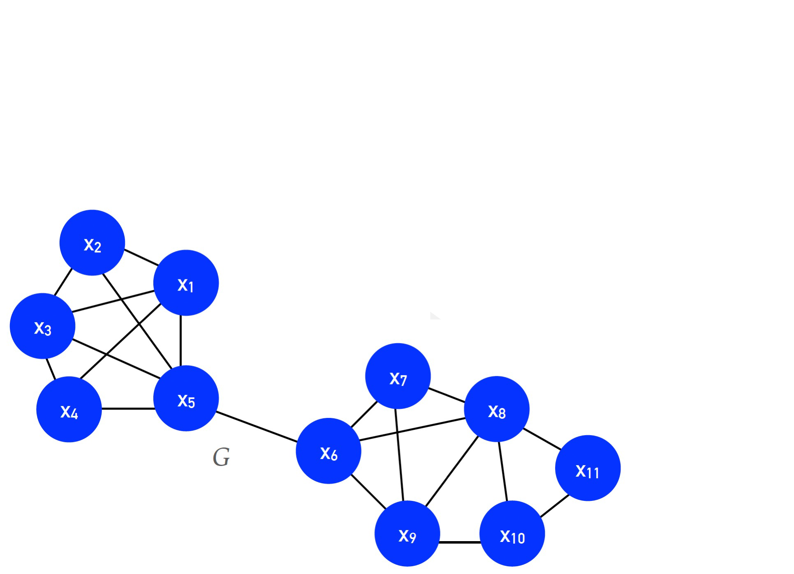

Graph Data
$$G=\left(V, E\right)$$
$$V=set of vertices$$
$$E⊆V×V, is the set of vertices in the graph$$

Slide 4
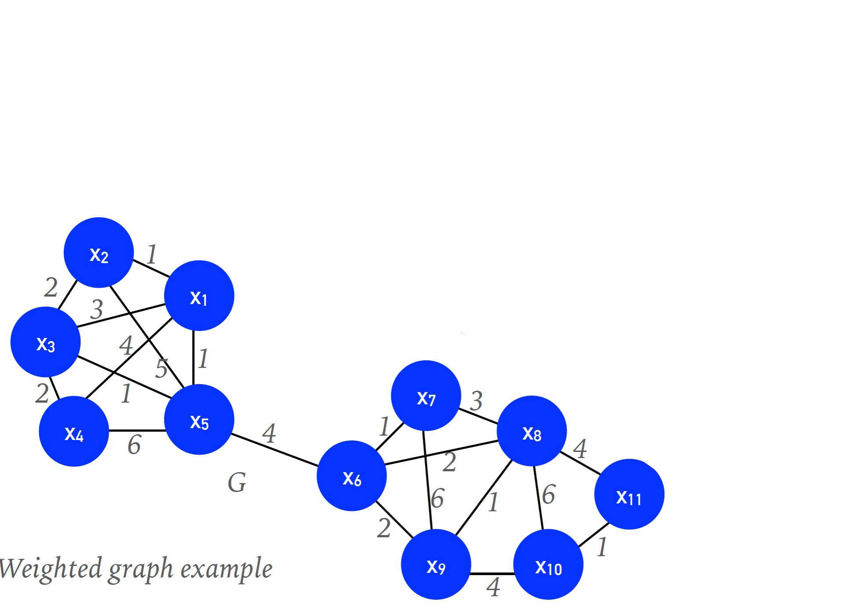
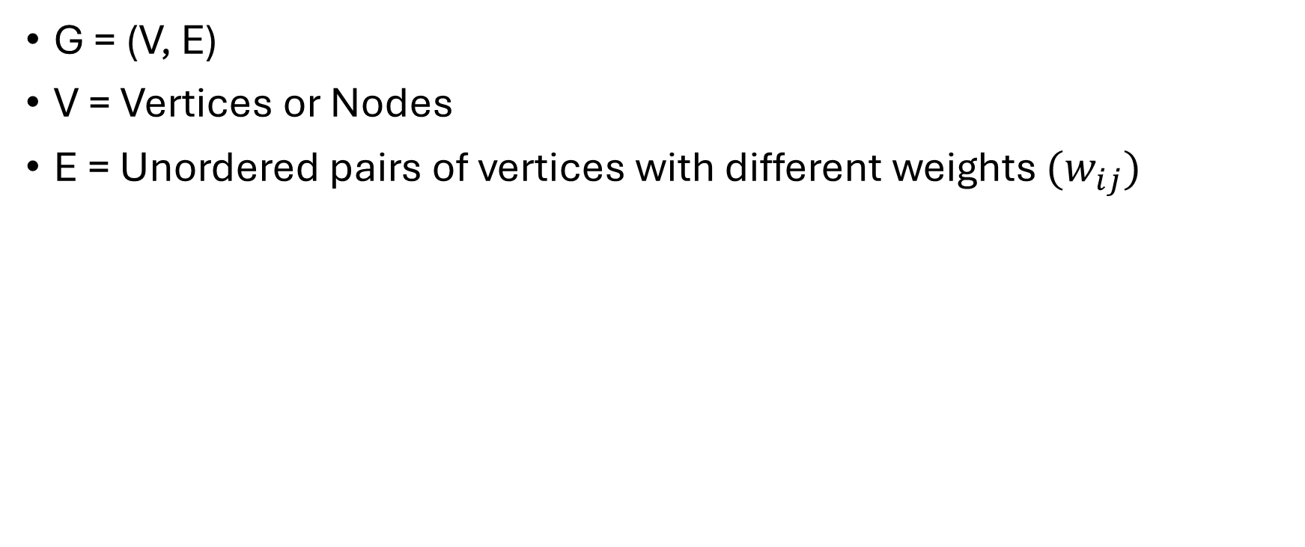
Graph Data (Weighted graph)
G = (V, E)
V = Vertices or Nodes
E = Unordered pairs of vertices with different weights $(w_{ij})$

Slide 5
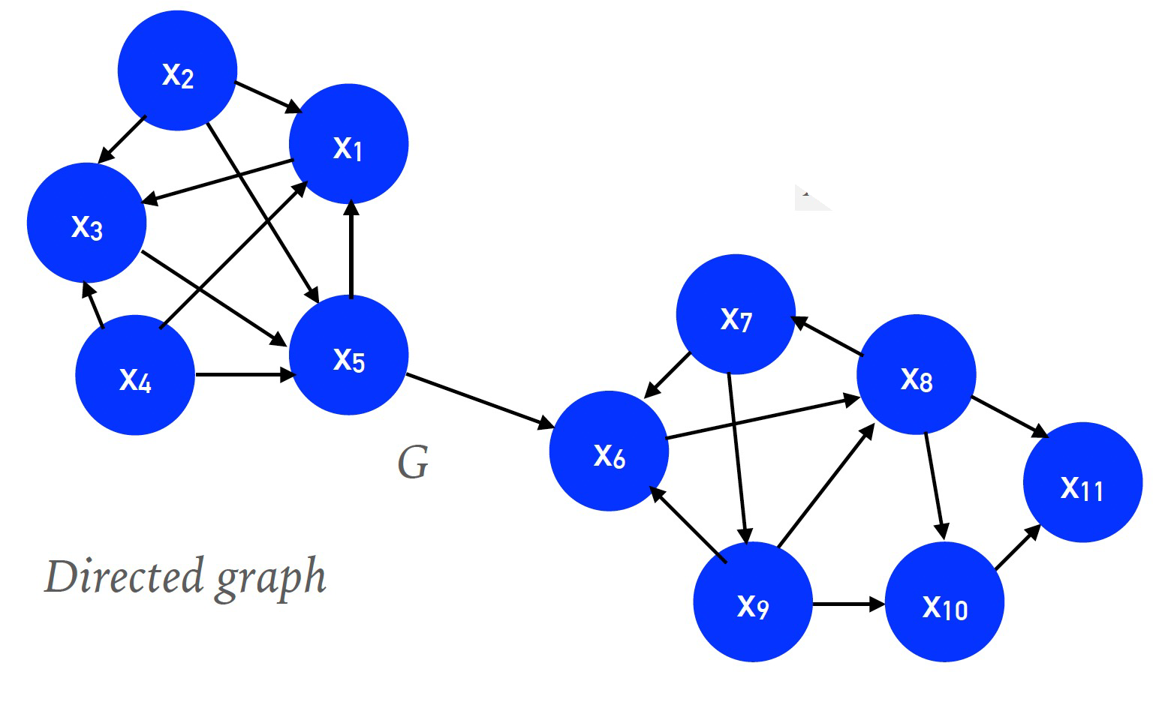
Graph Data (Directed Graph)
G = (V, E)
V = Vertices or Nodes
E = ordered pairs of vertices.

Slide 6
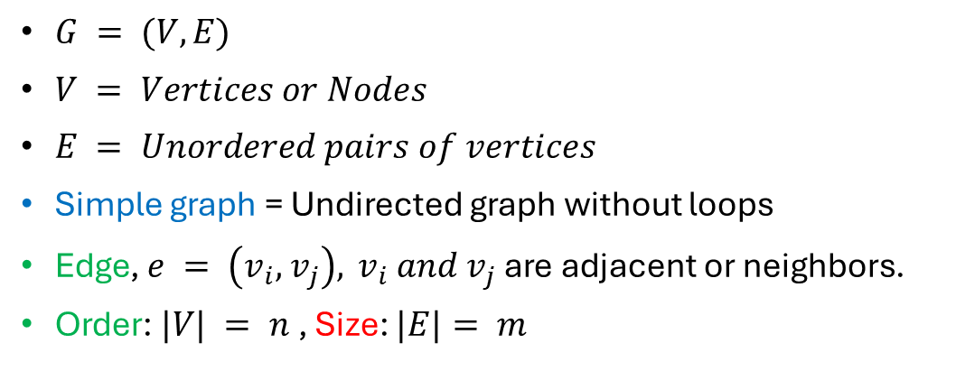
Graph Data
$G = (V, E)$
$V = Vertices or Nodes$
$E = Unordered pairs of vertices$
Simple graph = Undirected graph without loops
Edge, $e = \left(v_{i}, { v}_{j}\right),{ v}_{i} and v_{j}$ are adjacent or neighbors.
Order: $|V| = n$, Size: $|E|= m$

Slide 7
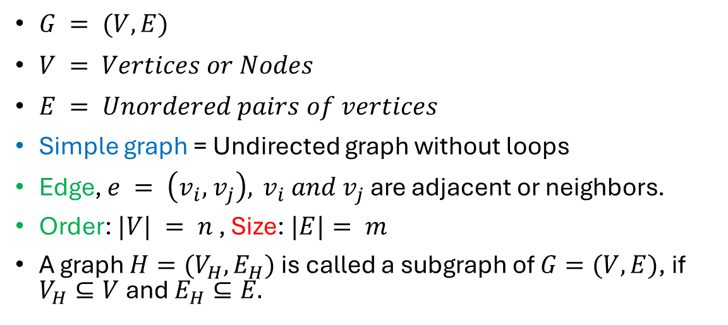
Graph Data
$G = (V, E)$
$V = Vertices or Nodes$
$E = Unordered pairs of vertices$
Simple graph = Undirected graph without loops
Edge, $e = \left(v_{i}, { v}_{j}\right),{ v}_{i} and v_{j}$ are adjacent or neighbors.
Order: $|V| = n$, Size: $|E|= m$
A graph $H=(V_{H}, E_{H})$ is called a subgraph of $G=(V, E)$, if $V_{H}⊆V$ and $E_{H}⊆E.$

Slide 8
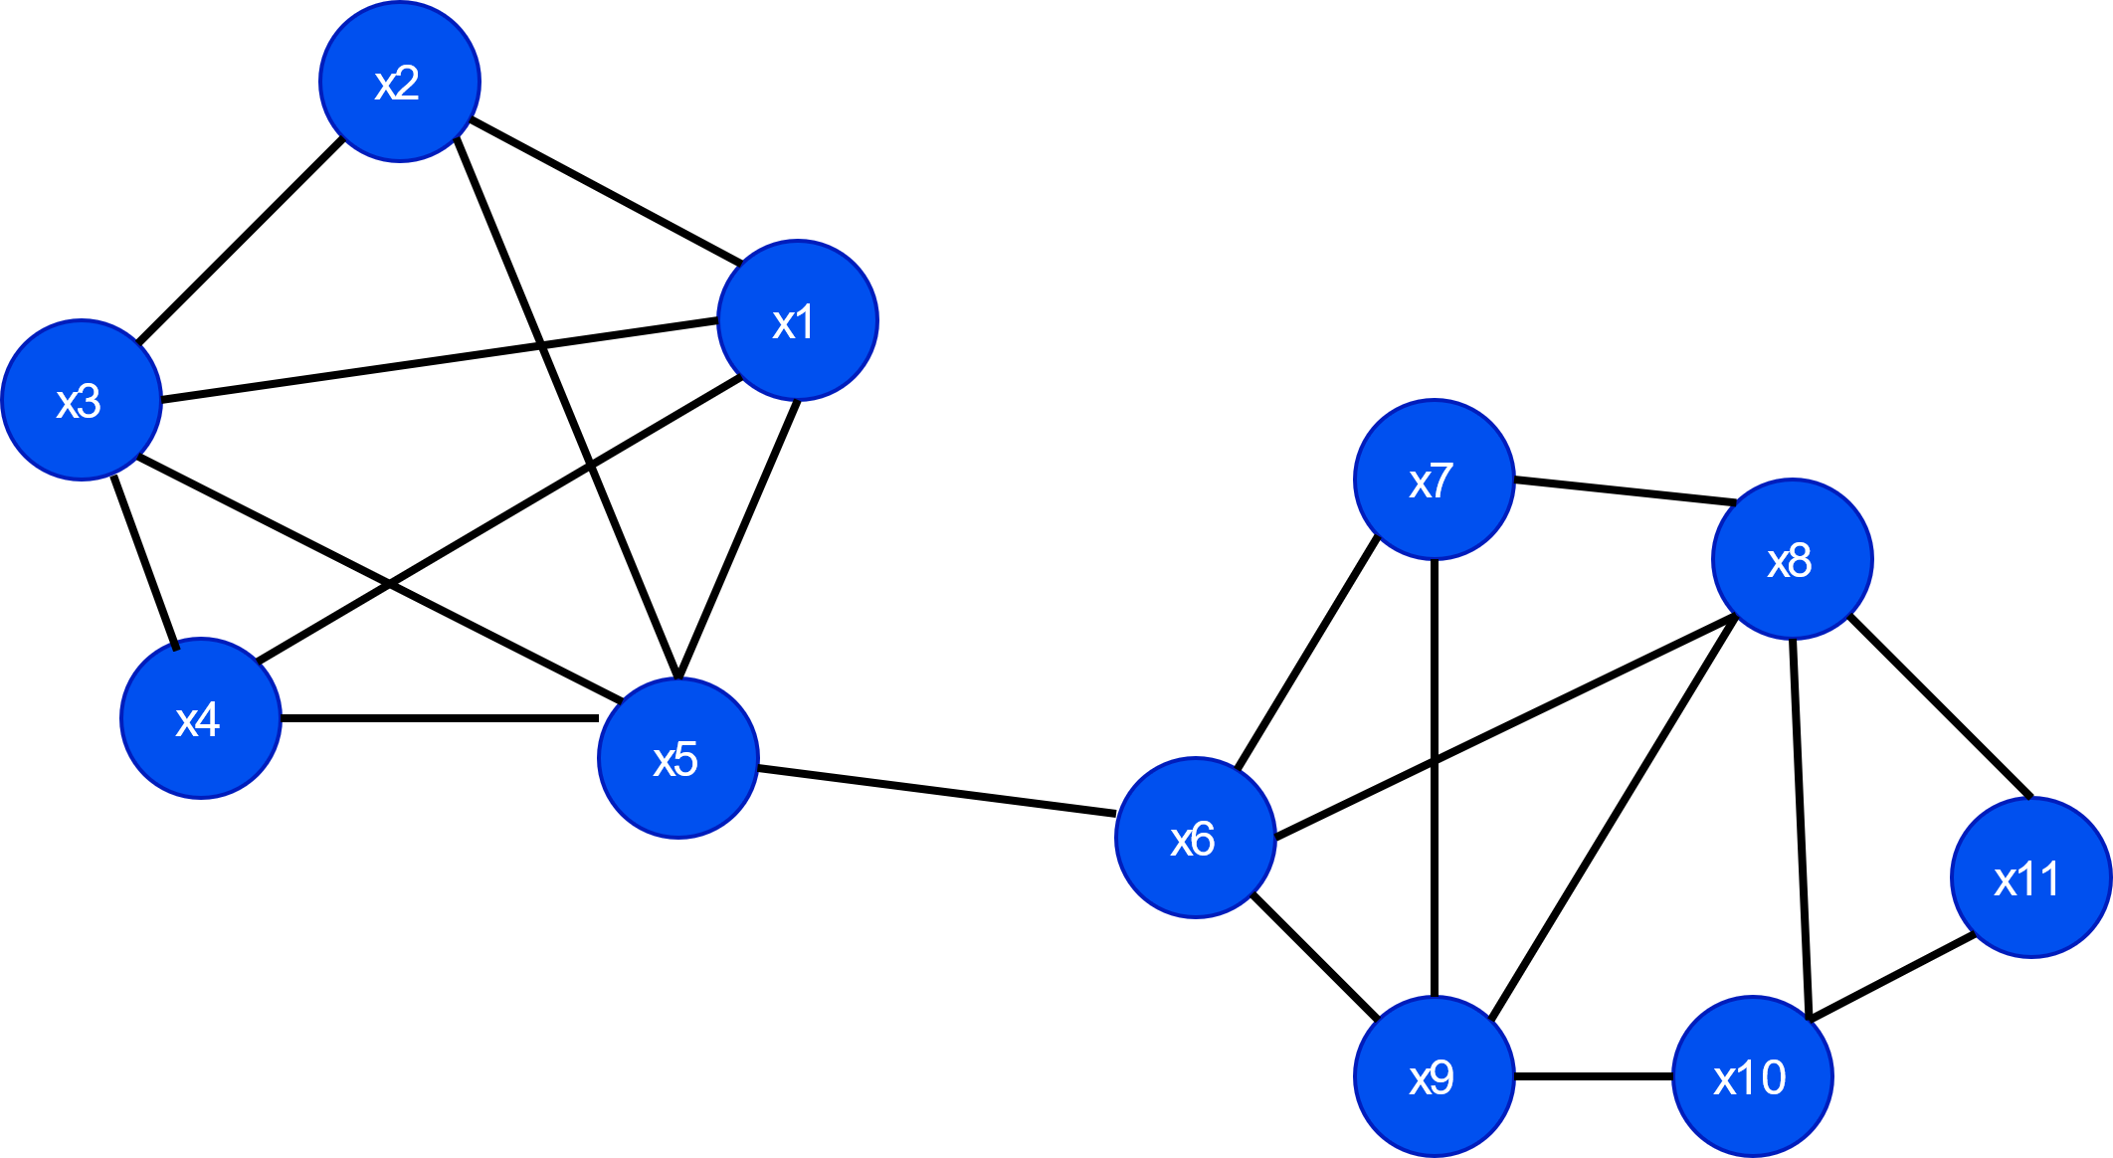
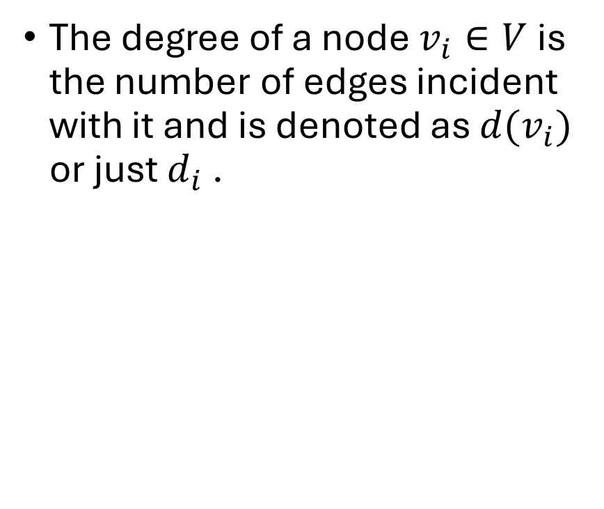
Degree of a node
The degree of a node $v_{i}∈V$is the number of edges incident with it and is denoted as $d(v_{i})$ or just $d_{i}$ .

Slide 9
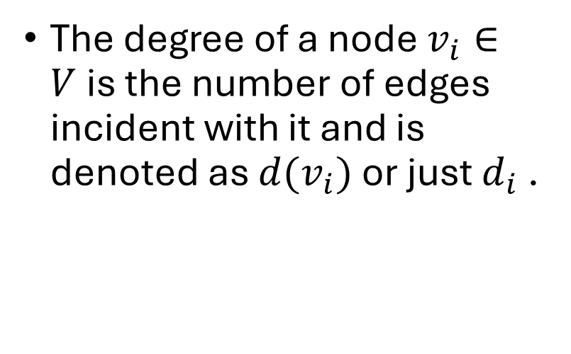
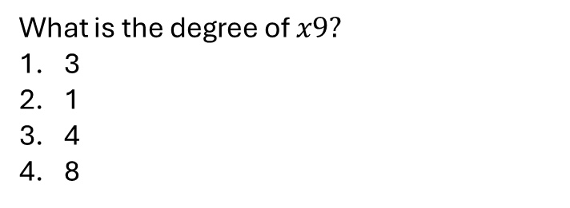
Degree of a node
The degree of a node $v_{i}∈V$is the number of edges incident with it and is denoted as $d(v_{i})$ or just $d_{i}$ .
What is the degree of $x9?$
3
1
4
8

Slide 10
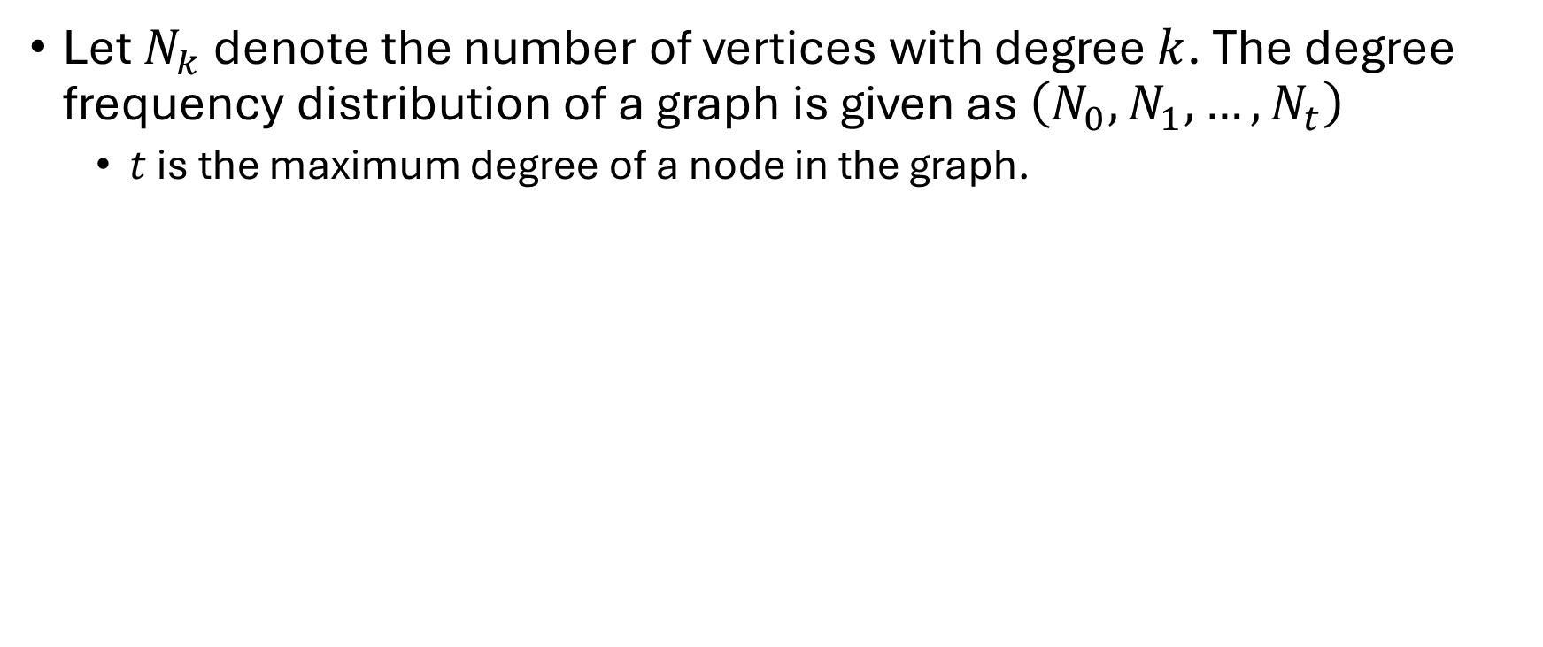
Degree Distribution
Let $N_{k}$ denote the number of vertices with degree $k$. The degree frequency distribution of a graph is given as $\left(N_{0},N_{1},…, N_{t}\right)$
$t$ is the maximum degree of a node in the graph.

Slide 11
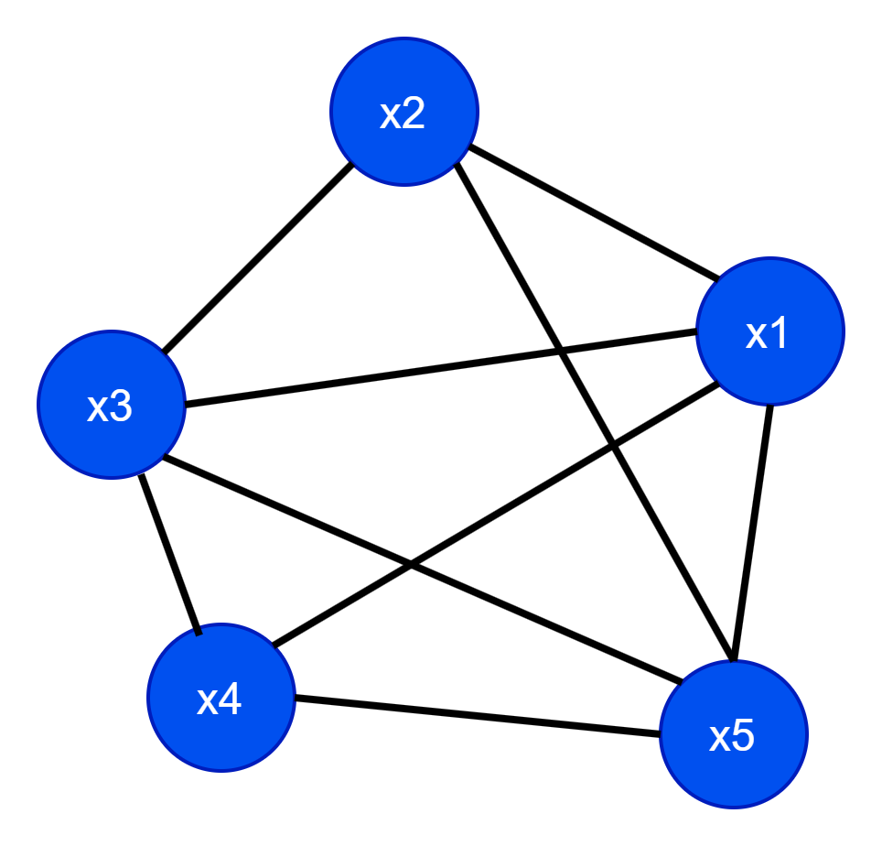
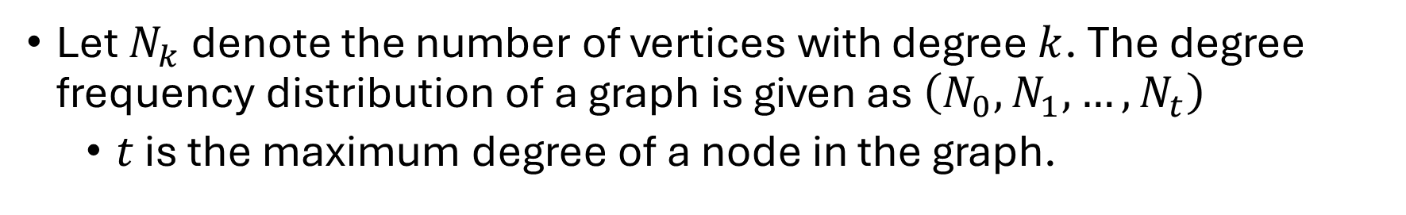
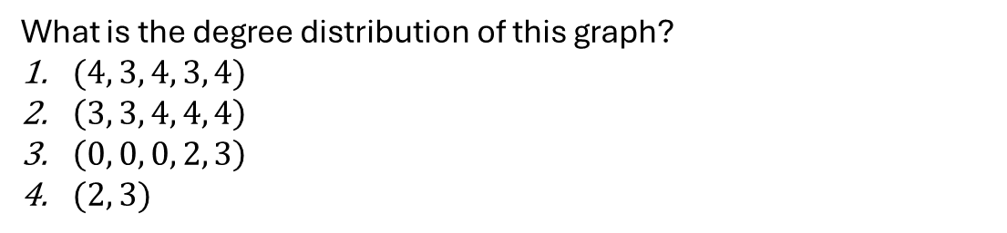
Degree Distribution
Let $N_{k}$ denote the number of vertices with degree $k$. The degree frequency distribution of a graph is given as $\left(N_{0},N_{1},…, N_{t}\right)$
$t$ is the maximum degree of a node in the graph.
What is the degree distribution of this graph?
$(4, 3, 4, 3, 4)$
$\left(3, 3, 4, 4, 4\right)$
$\left(0, 0, 0, 2, 3\right)$
$(2, 3)$

Slide 12
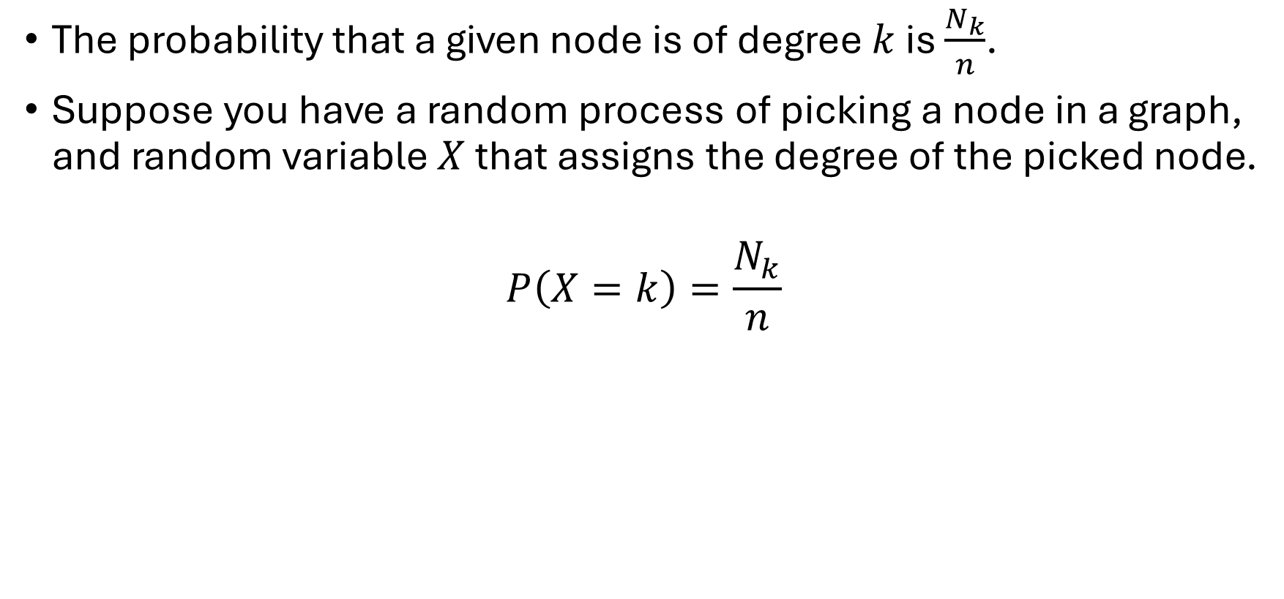
Degree Distribution
The probability that a given node is of degree $k$ is $\frac{N_{k}}{n}$.
Suppose you have a random process of picking a node in a graph, and random variable $X$ that assigns the degree of the picked node.
$$P\left(X=k\right)=\frac{N_{k}}{n}$$

Slide 13
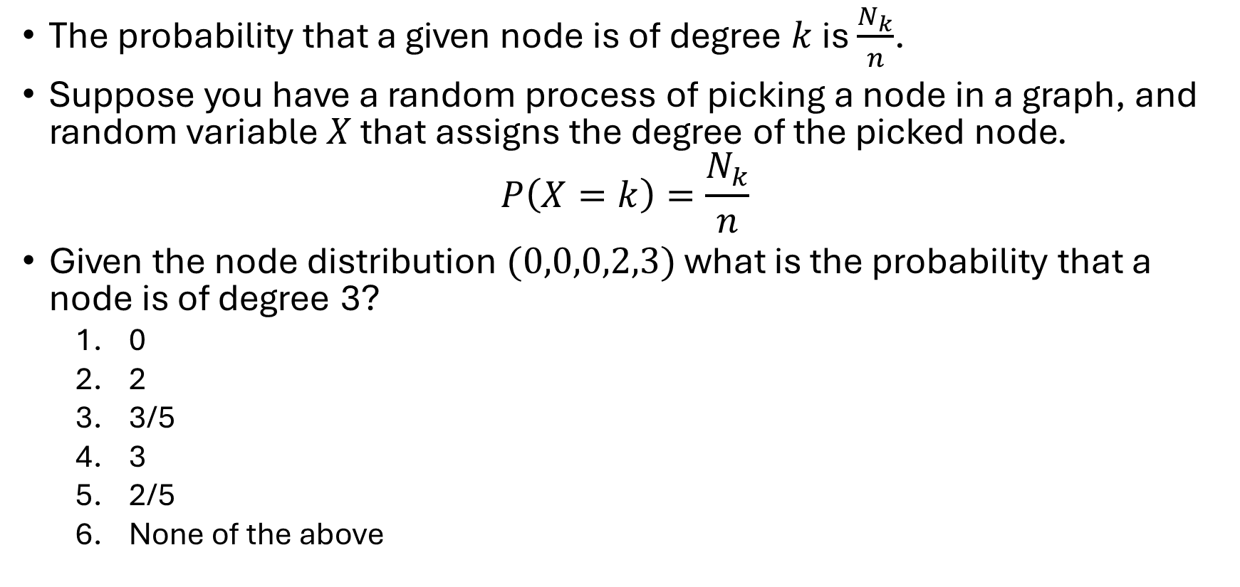
Degree Distribution
The probability that a given node is of degree $k$ is $\frac{N_{k}}{n}$.
Suppose you have a random process of picking a node in a graph, and random variable $X$ that assigns the degree of the picked node.
$$P\left(X=k\right)=\frac{N_{k}}{n}$$
Given the node distribution $(0,0,0,2,3)$ what is the probability that a node is of degree 3?
0
2
3/5
3
2/5
None of the above

Slide 14
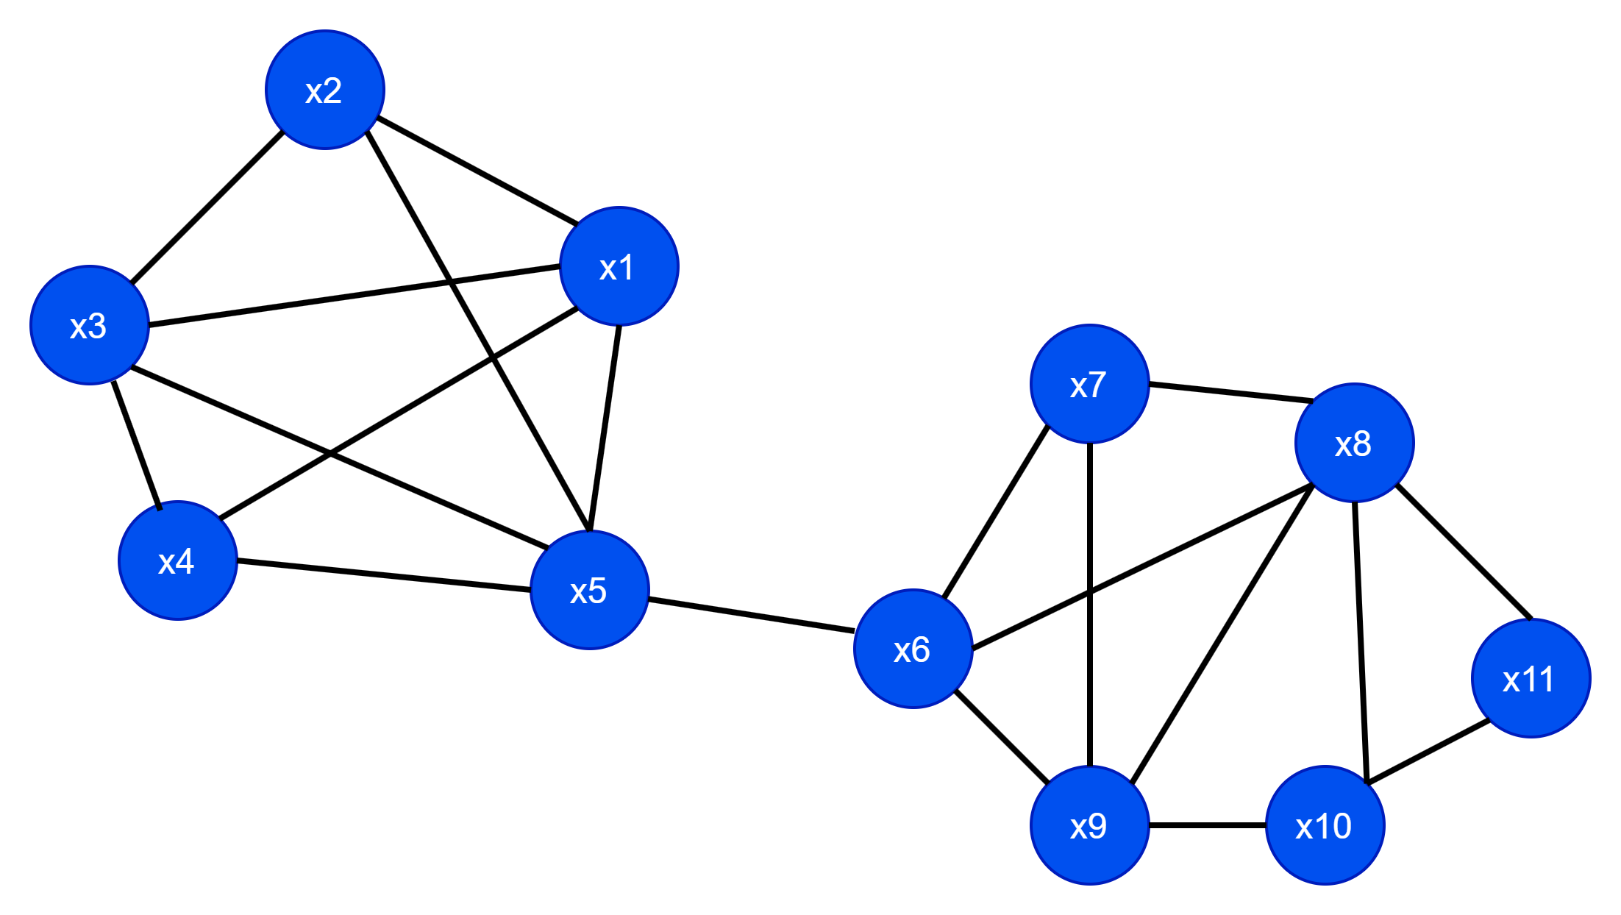
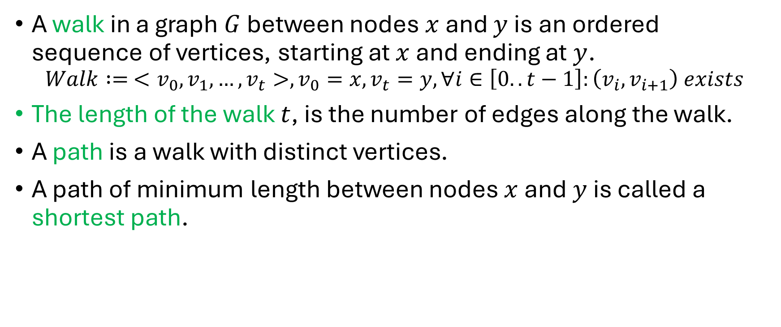
Walk, Path, shortest path
A walk in a graph $G$ between nodes $x$ and $y$ is an ordered sequence of vertices, starting at $x$ and ending at $y$.
$$Walk := <v_{0},v_{1},…,v_{t}>,v_{0}=x, v_{t}=y, ∀i∈\left[0..t−1\right]:\left(v_{i},v_{i+1}\right) exists$$
The length of the walk $t$, is the number of edges along the walk.
A path is a walk with distinct vertices.
A path of minimum length between nodes $x$ and $y$ is called a shortest path.

Slide 15
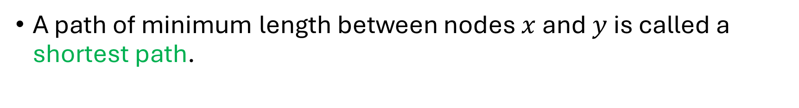
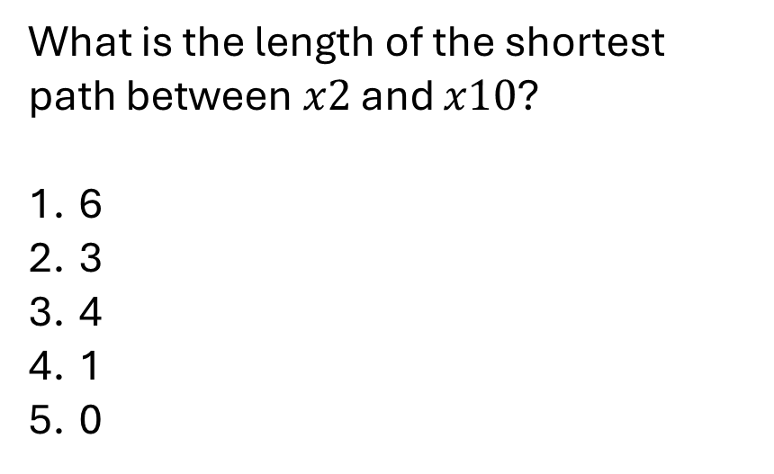
Walk, Path, shortest path
A path of minimum length between nodes $x$ and $y$ is called a shortest path.
What is the length of the shortest path between $x2$ and $x10$?
6
3
4
1
0

Slide 16
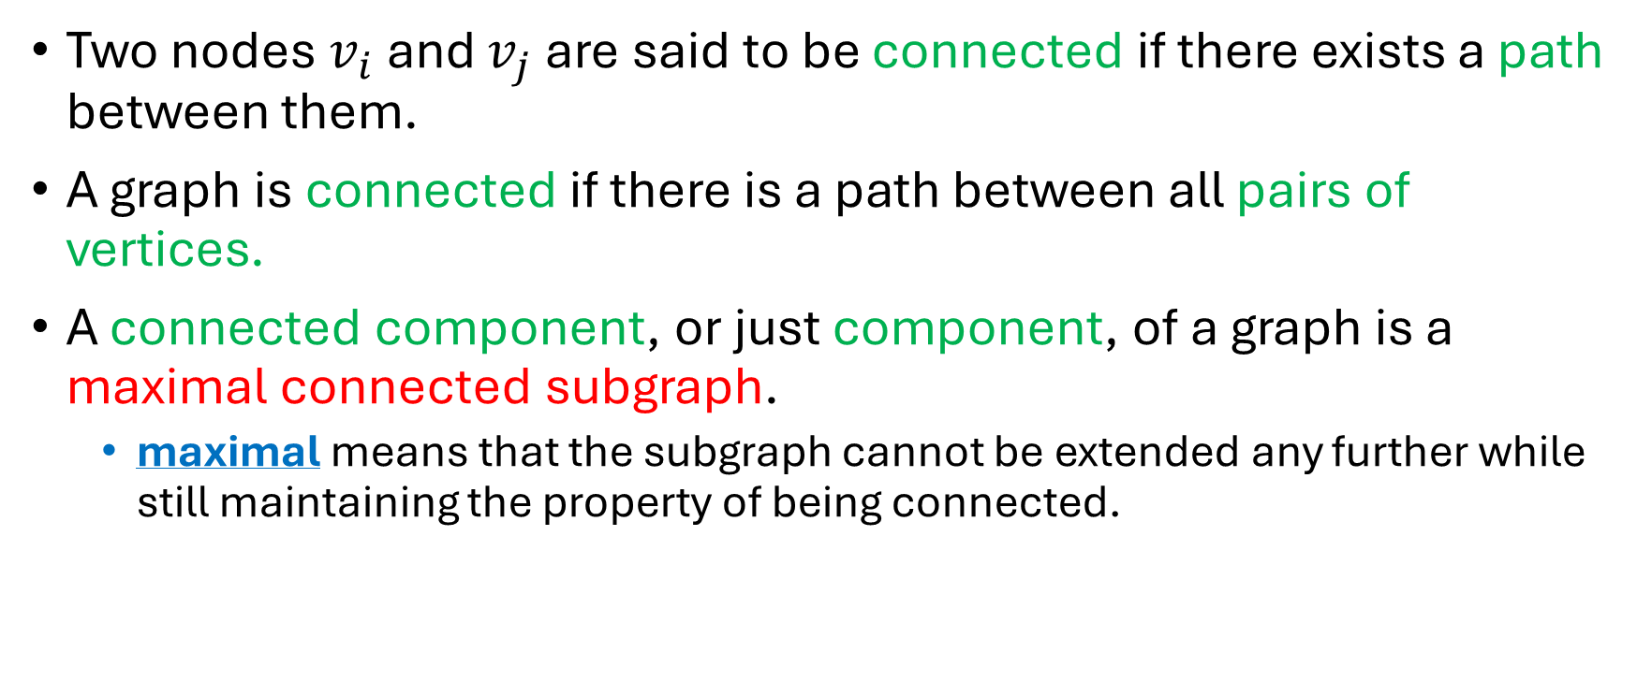
Connectedness
Two nodes $v_{i}$ and $v_{j}$ are said to be connected if there exists a path between them.
A graph is connected if there is a path between all pairs of vertices.
A connected component, or just component, of a graph is a maximal connected subgraph.
maximal means that the subgraph cannot be extended any further while still maintaining the property of being connected.

Slide 17
Connectedness
Is this graph connected?
Yes
No

Slide 18
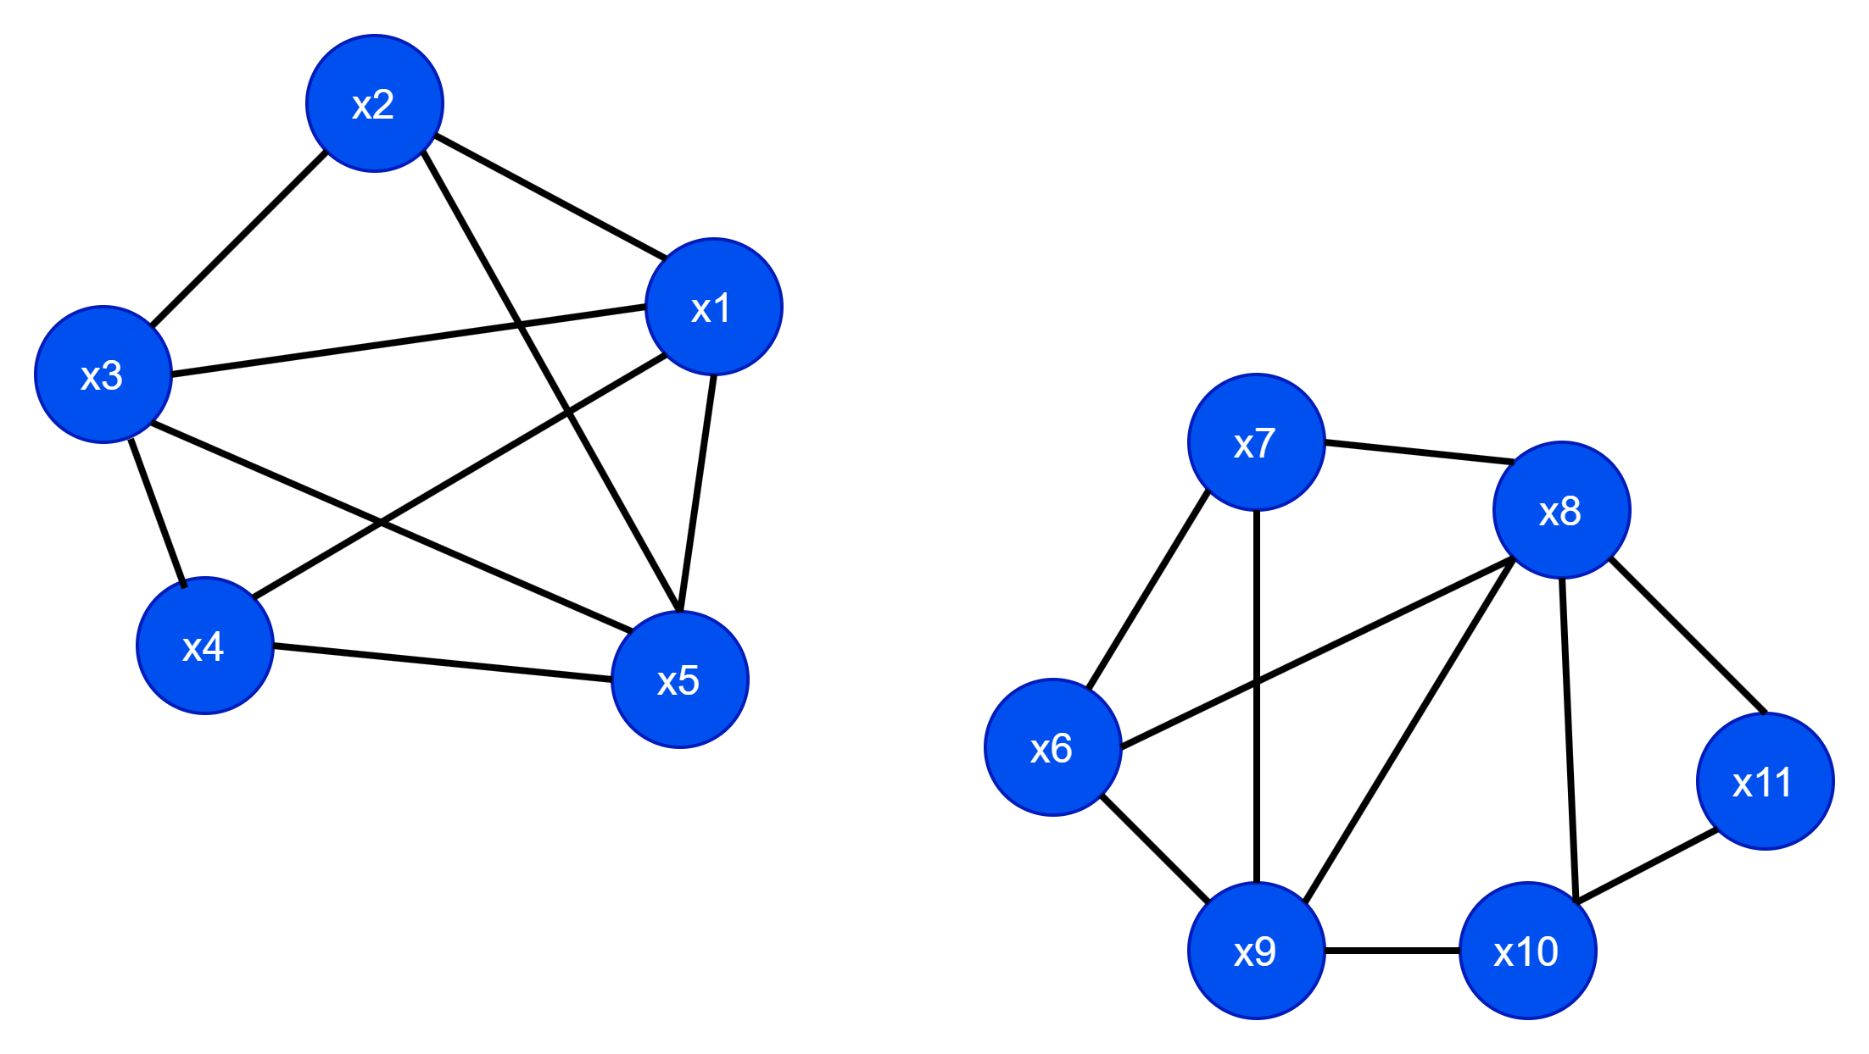
Connectedness
Is this graph connected?
Yes
No

Slide 19
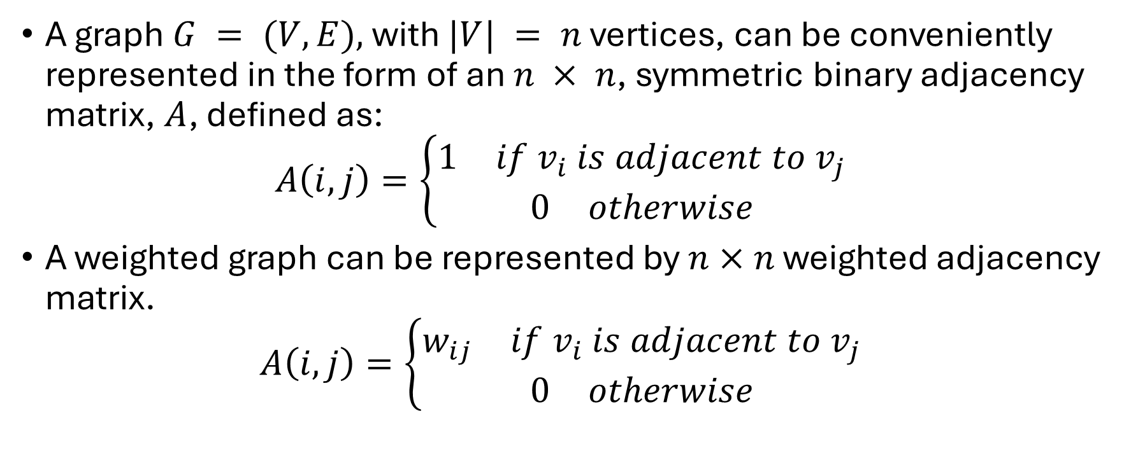
Adjacency Matrix
A graph $G = (V,E),$with $|V| = n$ vertices, can be conveniently represented in the form of an $n × n$, symmetric binary adjacency matrix, $A$, defined as:
$$A\left(i,j\right)=\left\{\begin{aligned}\begin{matrix}1 & if v_{i} is adjacent to v_{j}\end{matrix} \\ \begin{matrix}0 & otherwise\end{matrix}\end{aligned}\right.$$
A weighted graph can be represented by $n×n$ weighted adjacency matrix.
$$A\left(i,j\right)=\left\{\begin{aligned}\begin{matrix}w_{ij} & if v_{i} is adjacent to v_{j}\end{matrix} \\ \begin{matrix}0 & otherwise\end{matrix}\end{aligned}\right.$$

Slide 20

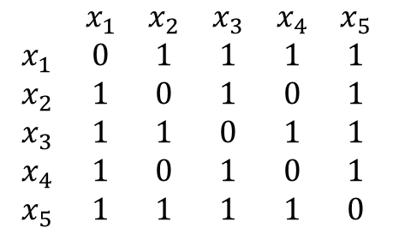
Adjacency matrix example.
$$\begin{matrix} & x_{1} & x_{2} & x_{3} & x_{4} & x_{5} \\ x_{1} & 0 & 1 & 1 & 1 & 1 \\ x_{2} & 1 & 0 & 1 & 0 & 1 \\ x_{3} & 1 & 1 & 0 & 1 & 1 \\ x_{4} & 1 & 0 & 1 & 0 & 1 \\ x_{5} & 1 & 1 & 1 & 1 & 0\end{matrix}$$

Slide 21
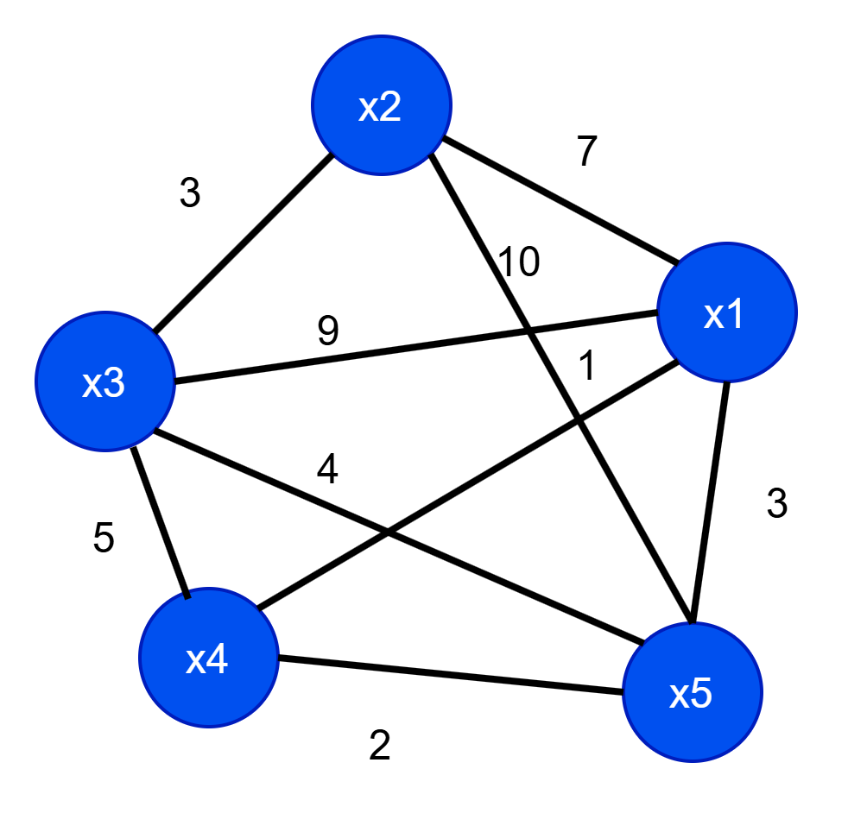
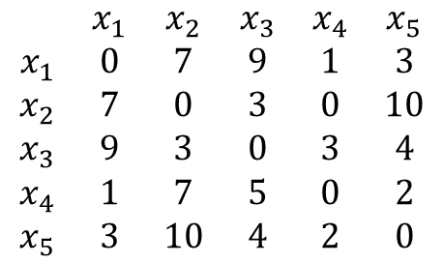
Adjacency matrix (weighted) example.
$$\begin{matrix} & x_{1} & x_{2} & x_{3} & x_{4} & x_{5} \\ x_{1} & 0 & 7 & 9 & 1 & 3 \\ x_{2} & 7 & 0 & 3 & 0 & 10 \\ x_{3} & 9 & 3 & 0 & 3 & 4 \\ x_{4} & 1 & 7 & 5 & 0 & 2 \\ x_{5} & 3 & 10 & 4 & 2 & 0\end{matrix}$$

Slide 22
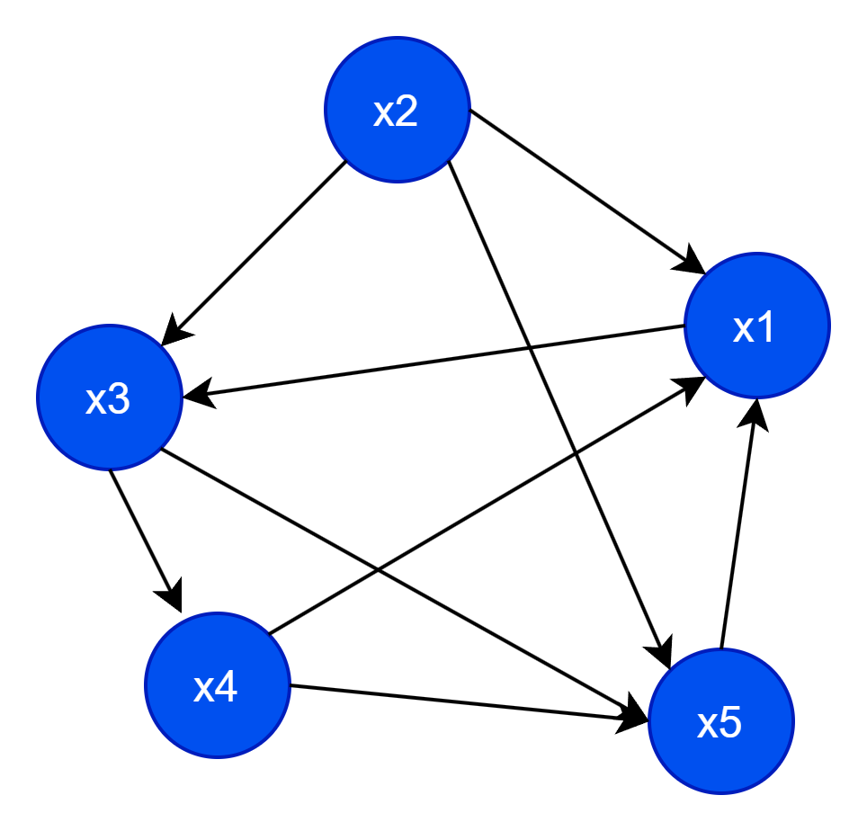
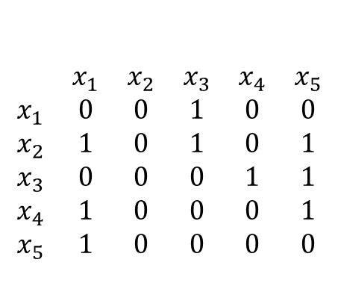
Adjacency matrix: directed graph
In a directed graph adjacency matrix is not symmetric.
$$\begin{matrix} & x_{1} & x_{2} & x_{3} & x_{4} & x_{5} \\ x_{1} & 0 & 0 & 1 & 0 & 0 \\ x_{2} & 1 & 0 & 1 & 0 & 1 \\ x_{3} & 0 & 0 & 0 & 1 & 1 \\ x_{4} & 1 & 0 & 0 & 0 & 1 \\ x_{5} & 1 & 0 & 0 & 0 & 0\end{matrix}$$

Slide 23

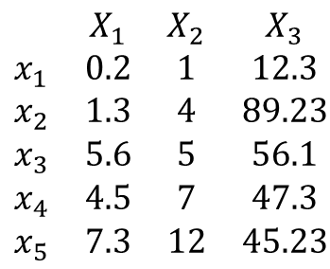

Graphs from Data Matrix
Given a dataset in the form of a matrix, can we create a graph?
$$\begin{matrix} & X_{1} & X_{2} & X_{3} \\ x_{1} & 0.2 & 1 & 12.3 \\ x_{2} & 1.3 & 4 & 89.23 \\ x_{3} & 5.6 & 5 & 56.1 \\ x_{4} & 4.5 & 7 & 47.3 \\ x_{5} & 7.3 & 12 & 45.23\end{matrix}$$
$$?$$
But what can we do about the edges?

Slide 24
Graphs from Data Matrix
Given a dataset in the form of a matrix, can we create a graph?
$$\begin{matrix} & X_{1} & X_{2} & X_{3} \\ x_{1} & 0.2 & 1 & 12.3 \\ x_{2} & 1.3 & 4 & 89.23 \\ x_{3} & 5.6 & 5 & 56.1 \\ x_{4} & 4.5 & 7 & 47.3 \\ x_{5} & 7.3 & 12 & 45.23\end{matrix}$$
$$?$$
How about we using a similarity measure and then use the similarity measure as the edge weights?

Slide 25
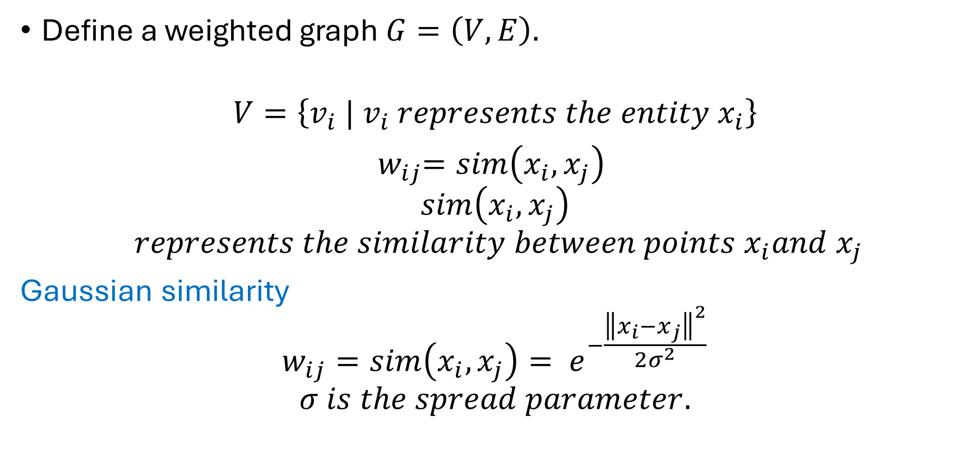
How to create a graph from matrix?
Define a weighted graph $G=\left(V,E\right).$
$$V=\left\{v_{i} | v_{i} represents the entity x_{i}\right\}$$
${ w}_{ij}=sim\left(x_{i}, x_{j}\right)$
$$sim\left(x_{i}, x_{j}\right)$$
$$represents the similarity between points x_{i}and x_{j}$$
Gaussian similarity
$$w_{ij}=sim\left(x_{i}, x_{j}\right)= e^{−\frac{{\left\|x_{i}−x_{j}\right\|}^{2}}{2σ^{2}}}$$
$$σ is the spread parameter.$$

Slide 26
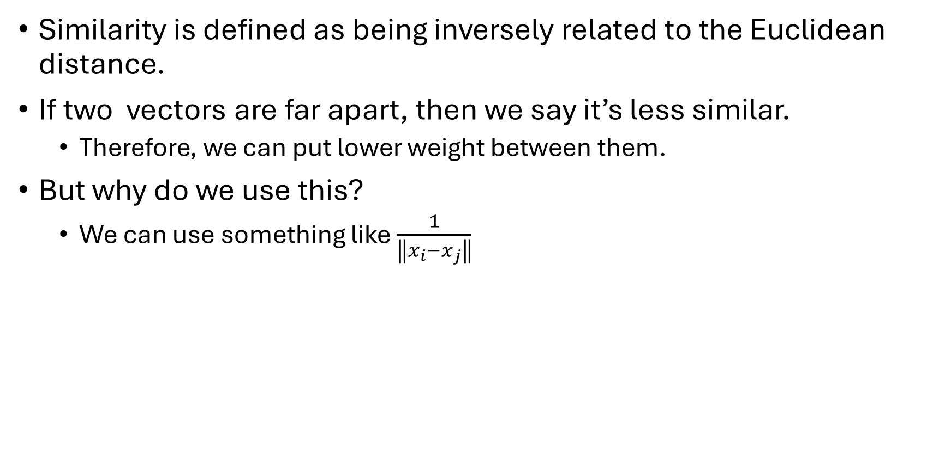
Gaussian similarity
Similarity is defined as being inversely related to the Euclidean distance.
If two vectors are far apart, then we say it’s less similar.
Therefore, we can put lower weight between them.
But why do we use this?
We can use something like $\frac{1}{\left\|x_{i}−x_{j}\right\|}$

Slide 27
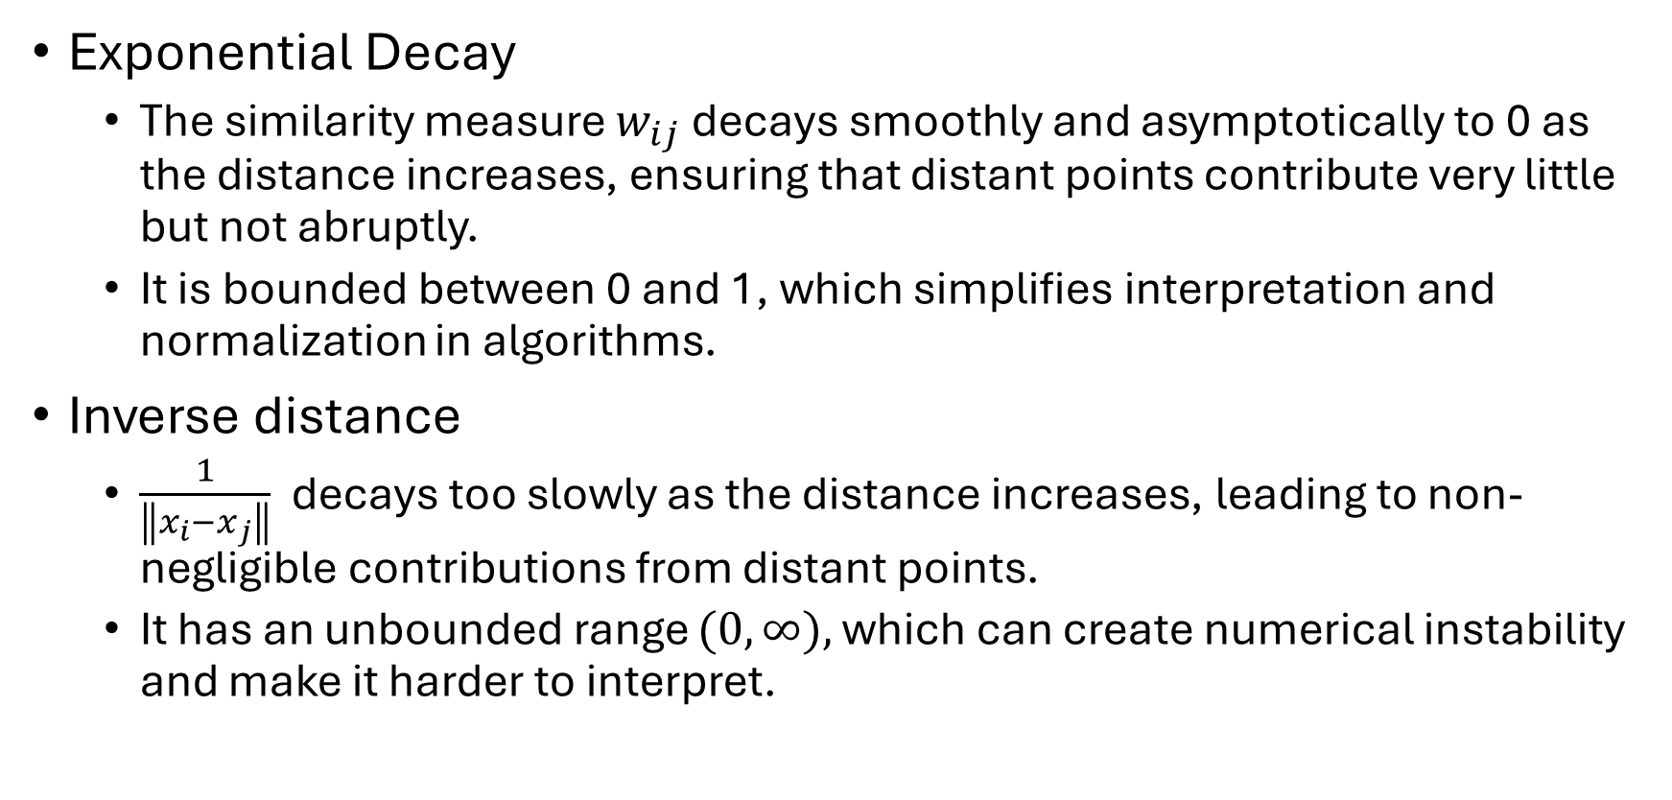
Gaussian similarity
Exponential Decay
The similarity measure $w_{ij}$ decays smoothly and asymptotically to 0 as the distance increases, ensuring that distant points contribute very little but not abruptly.
It is bounded between 0 and 1, which simplifies interpretation and normalization in algorithms.
Inverse distance
$\frac{1}{\left\|x_{i}−x_{j}\right\|}$ decays too slowly as the distance increases, leading to non-negligible contributions from distant points.
It has an unbounded range $(0,∞),$which can create numerical instability and make it harder to interpret.

Slide 28
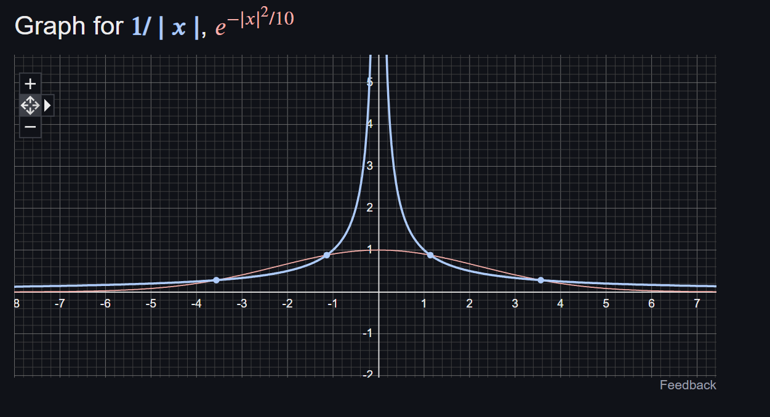

Slide 29
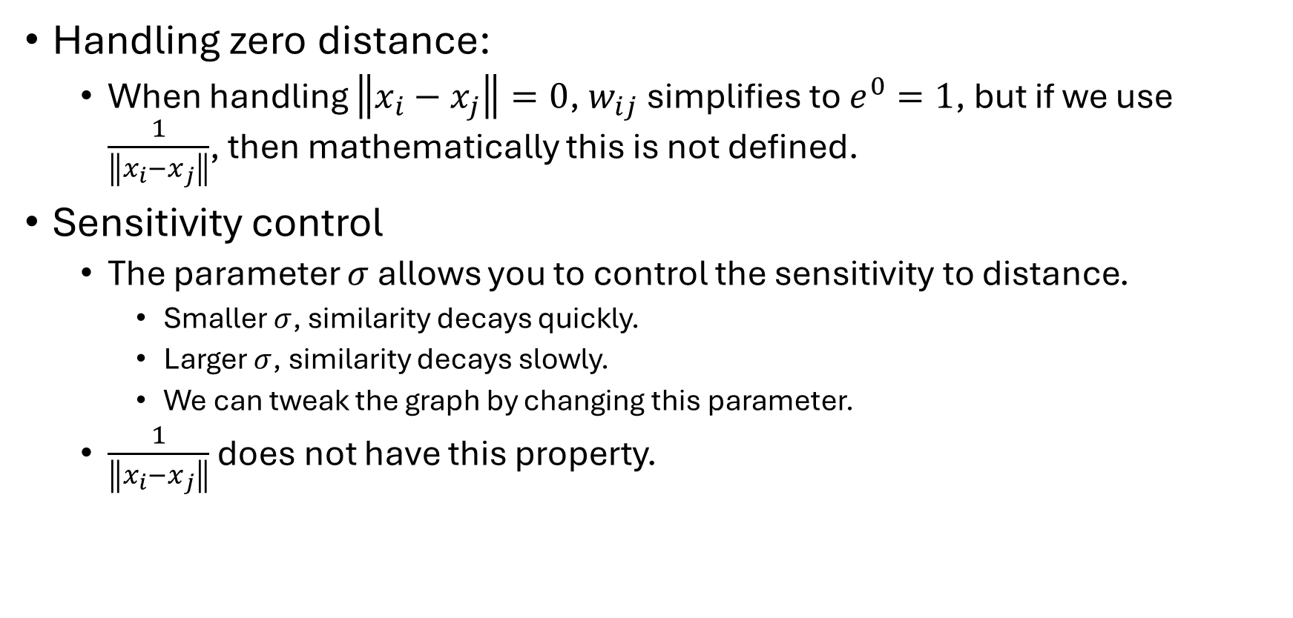
Gaussian similarity
Handling zero distance:
When handling $\left\|x_{i}−x_{j}\right\|=0$, $w_{ij}$ simplifies to $e^{0}=1$, but if we use $\frac{1}{\left\|x_{i}−x_{j}\right\|}$, then mathematically this is not defined.
Sensitivity control
The parameter $σ$ allows you to control the sensitivity to distance.
Smaller $σ$, similarity decays quickly.
Larger $σ$, similarity decays slowly.
We can tweak the graph by changing this parameter.
$\frac{1}{\left\|x_{i}−x_{j}\right\|}$ does not have this property.

Slide 30
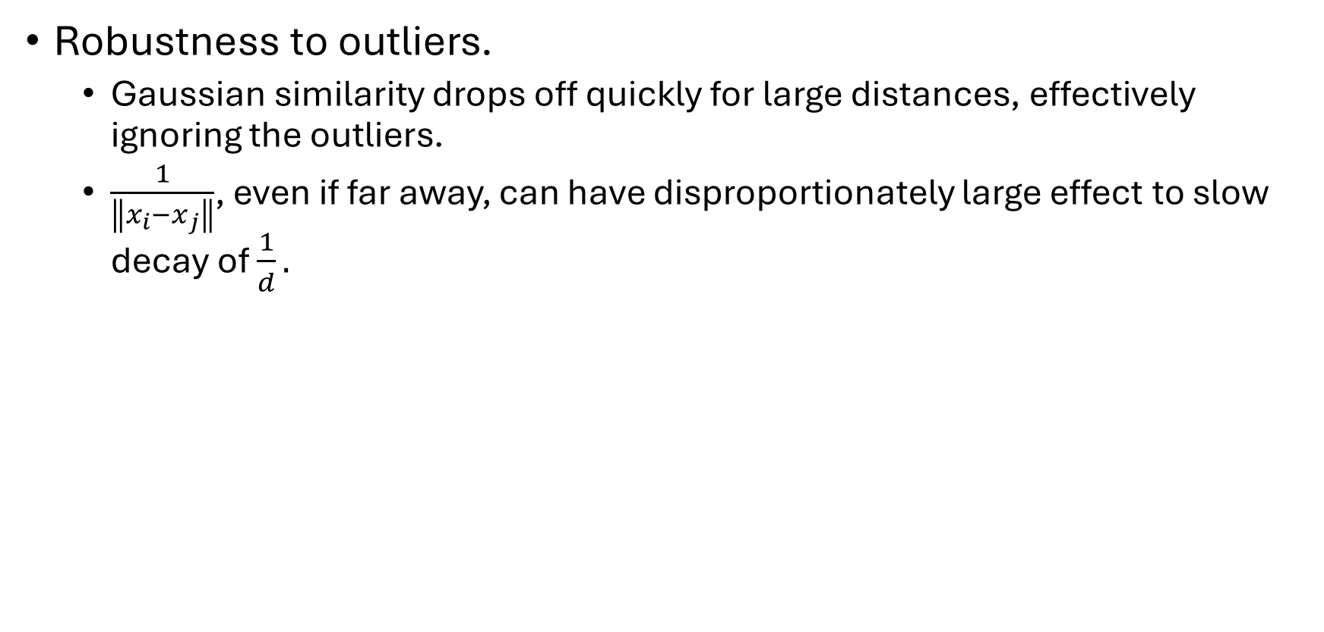
Gaussian similarity
Robustness to outliers.
Gaussian similarity drops off quickly for large distances, effectively ignoring the outliers.
$\frac{1}{\left\|x_{i}−x_{j}\right\|}$, even if far away, can have disproportionately large effect to slow decay of $\frac{1}{d}.$

Slide 31
Graphs from Data Matrix
Gaussian similarity with $σ=25$
$$\begin{matrix} & X_{1} & X_{2} & X_{3} \\ x_{1} & 0.2 & 1 & 12.3 \\ x_{2} & 1.3 & 4 & 89.23 \\ x_{3} & 5.6 & 5 & 56.1 \\ x_{4} & 4.5 & 7 & 47.3 \\ x_{5} & 7.3 & 12 & 45.23\end{matrix}$$
0 | 0.008709 | 0.207862 | 0.359302 | 0.366178
0.008709 | 0 | 0.409967 | 0.241611 | 0.196716
0.207862 | 0.409967 | 0 | 0.936019 | 0.87281
0.359302 | 0.241611 | 0.936019 | 0 | 0.970737
0.366178 | 0.196716 | 0.87281 | 0.970737 | 0

Slide 32
Graphs from Data Matrix
Gaussian similarity with $σ=25$
$$\begin{matrix} & X_{1} & X_{2} & X_{3} \\ x_{1} & 0.2 & 1 & 12.3 \\ x_{2} & 1.3 & 4 & 89.23 \\ x_{3} & 5.6 & 5 & 56.1 \\ x_{4} & 4.5 & 7 & 47.3 \\ x_{5} & 7.3 & 12 & 45.23\end{matrix}$$
 | x1 | x2 | x3 | x4 | x5
x1 | 0 | 0.008709 | 0.207862 | 0.359302 | 0.366178
x2 | 0.008709 | 0 | 0.409967 | 0.241611 | 0.196716
x3 | 0.207862 | 0.409967 | 0 | 0.936019 | 0.87281
x4 | 0.359302 | 0.241611 | 0.936019 | 0 | 0.970737
x5 | 0.366178 | 0.196716 | 0.87281 | 0.970737 | 0

Slide 33
Graphs from Data Matrix
Gaussian similarity with $σ=50$
$$\begin{matrix} & X_{1} & X_{2} & X_{3} \\ x_{1} & 0.2 & 1 & 12.3 \\ x_{2} & 1.3 & 4 & 89.23 \\ x_{3} & 5.6 & 5 & 56.1 \\ x_{4} & 4.5 & 7 & 47.3 \\ x_{5} & 7.3 & 12 & 45.23\end{matrix}$$
 | x1 | x2 | x3 | x4 | x5
x1 | 0 | 0.30549 | 0.675218 | 0.774221 | 0.777899
x2 | 0.30549 | 0 | 0.800179 | 0.701098 | 0.665978
x3 | 0.675218 | 0.800179 | 0 | 0.983606 | 0.966562
x4 | 0.774221 | 0.701098 | 0.983606 | 0 | 0.992603
x5 | 0.777899 | 0.665978 | 0.966562 | 0.992603 | 0

Slide 34
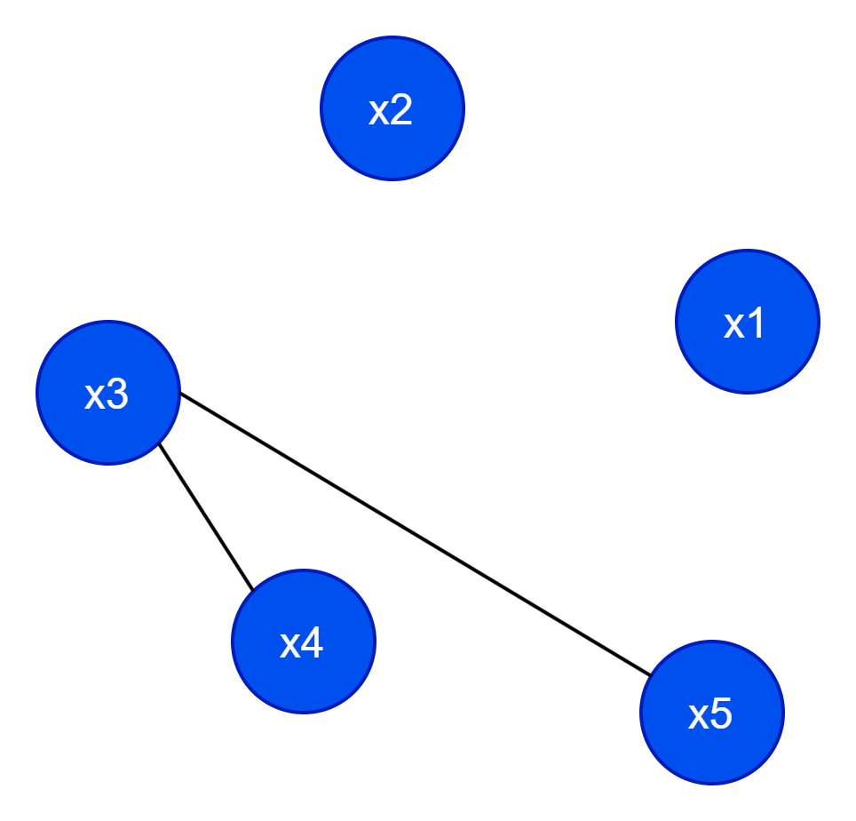
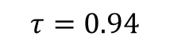
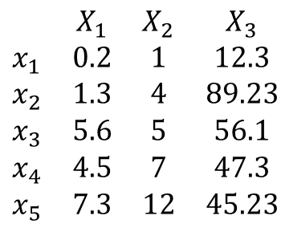


Creating a graph from matrix
$$τ=0.94$$
 | x1 | x2 | x3 | x4 | x5
x1 | 0 | 0.30549 | 0.675218 | 0.774221 | 0.777899
x2 | 0.30549 | 0 | 0.800179 | 0.701098 | 0.665978
x3 | 0.675218 | 0.800179 | 0 | 0.983606 | 0.966562
x4 | 0.774221 | 0.701098 | 0.983606 | 0 | 0.992603
x5 | 0.777899 | 0.665978 | 0.966562 | 0.992603 | 0
$$\begin{matrix} & X_{1} & X_{2} & X_{3} \\ x_{1} & 0.2 & 1 & 12.3 \\ x_{2} & 1.3 & 4 & 89.23 \\ x_{3} & 5.6 & 5 & 56.1 \\ x_{4} & 4.5 & 7 & 47.3 \\ x_{5} & 7.3 & 12 & 45.23\end{matrix}$$
 | x1 | x2 | x3 | x4 | x5
x1 | 0 | 0 | 0 | 0 | 0
x2 | 0 | 0 | 0 | 0 | 0
x3 | 0 | 0 | 0 | 1 | 1
x4 | 0 | 0 | 1 | 0 | 1
x5 | 0 | 0 | 1 | 1 | 0
$$sim(x_{i}, x_{j})=e^{−\frac{{\left\|x_{i}−x_{j}\right\|}^{2}}{2σ^{2}}}$$
$$A\left(i,j\right)=\left\{\begin{aligned}\begin{matrix}1 & ifsim\left(x_{i}, x_{j}\right)≥τ\end{matrix} \\ \begin{matrix}0 & otherwise \end{matrix}\end{aligned}\right.$$

Slide 35
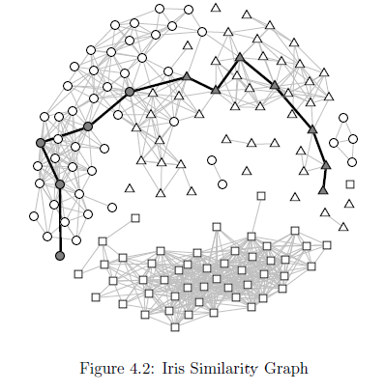
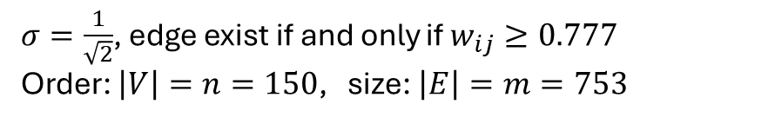
Iris Similarity Graph: Gaussian Similarity
$σ=\frac{1}{\sqrt{2}}$, edge exist if and only if $w_{ij}≥0.777$
Order: $\left|V\right|=n=150$, size: $\left|E\right|=m=753$

Slide 36
Topological graph attributes
Topological graph attributes refer to properties of a graph that describe its structure and connectivity without considering specific geometric or spatial embedding.
We say a graph attribute is:
Local if they apply only to a single node.
Global if they refer to the entire graph.

Slide 37
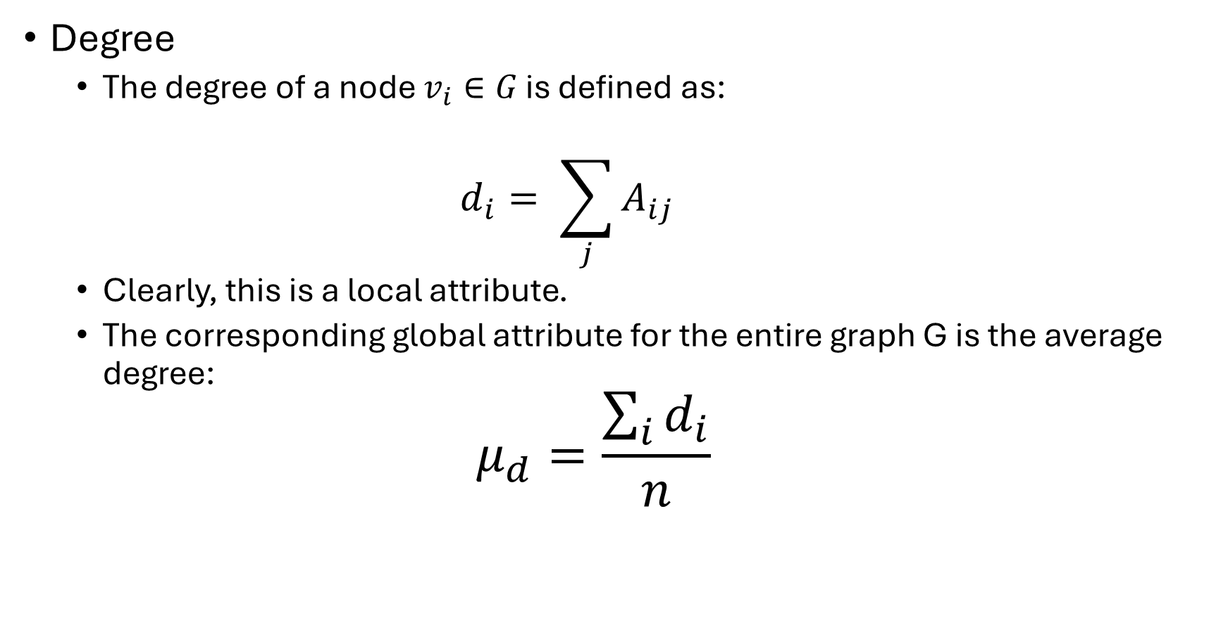
Degree
The degree of a node $v_{i}∈G$ is defined as:
$$d_{i}= \sum_{j}{A_{ij}}$$
Clearly, this is a local attribute.
The corresponding global attribute for the entire graph G is the average degree:
$$μ_{d}=\frac{\sum_{i}{d_{i}}}{n}$$

Slide 38
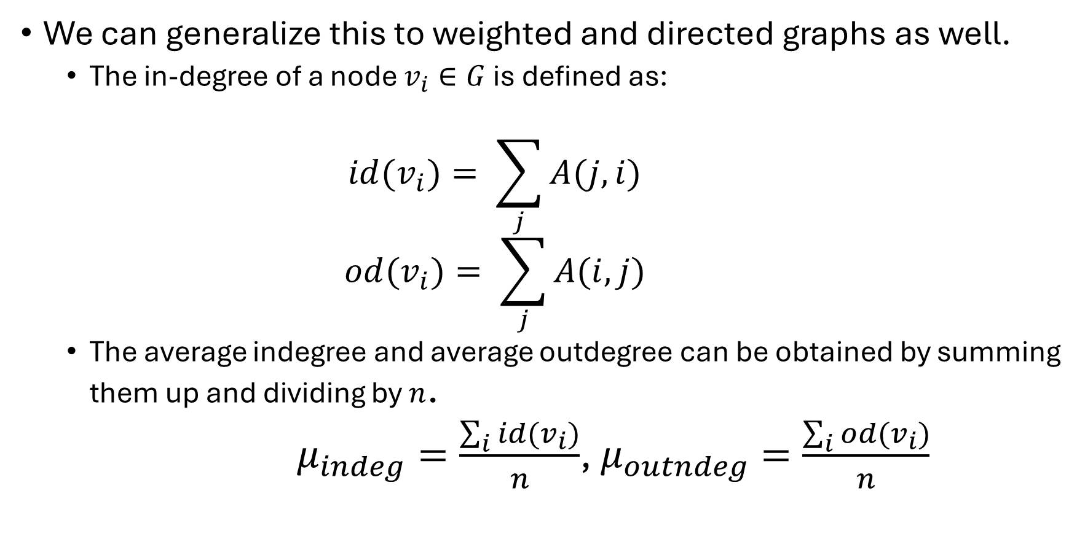
We can generalize this to weighted and directed graphs as well.
The in-degree of a node $v_{i}∈G$ is defined as:
$$id(v_{i})= \sum_{j}{A(j,i)}$$
$$od(v_{i})= \sum_{j}{A(i,j)}$$
The average indegree and average outdegree can be obtained by summing them up and dividing by $n$.
$μ_{indeg}=\frac{\sum_{i}{id(v_{i})}}{n}$, $μ_{outndeg}=\frac{\sum_{i}{od(v_{i})}}{n}$

Slide 39
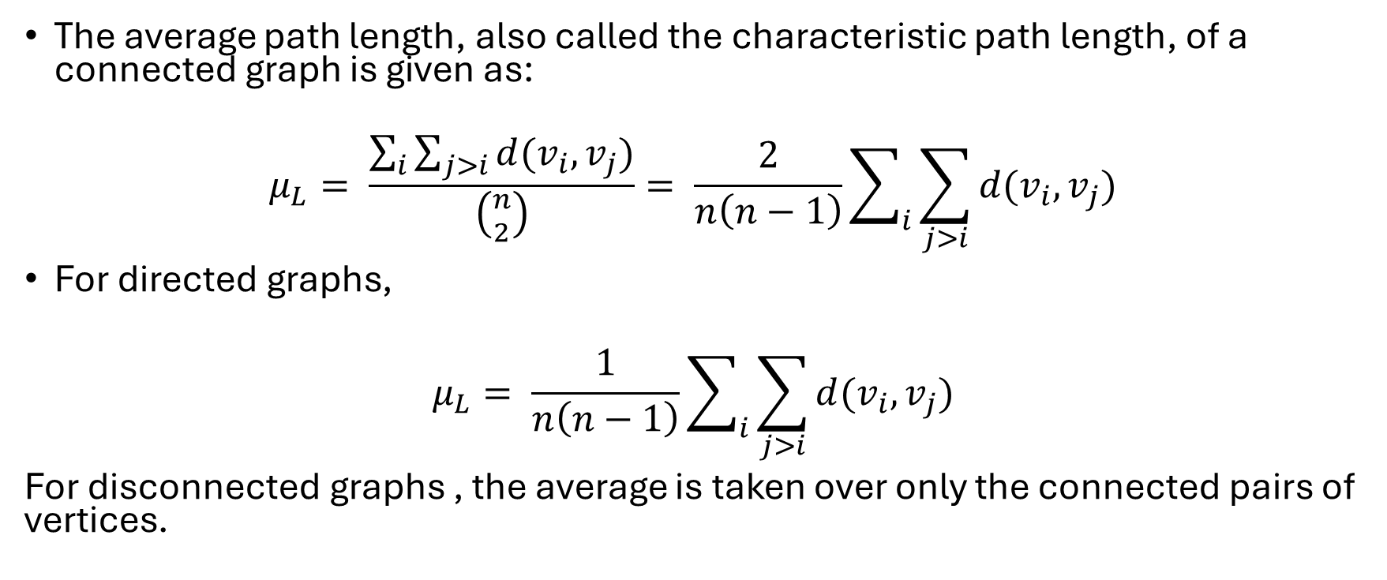
Average path length
The average path length, also called the characteristic path length, of a connected graph is given as:
$$μ_{L}= \frac{\sum_{i}{\sum_{j>i}{d(v_{i}, v_{j})}}}{\left({n \atop 2}\right)}= \frac{2}{n\left(n−1\right)}\sum_{i}{\sum_{j>i}{d(v_{i}, v_{j})}}$$
For directed graphs,
$$μ_{L}= \frac{1}{n\left(n−1\right)}\sum_{i}{\sum_{j>i}{d(v_{i}, v_{j})}}$$
For disconnected graphs , the average is taken over only the connected pairs of vertices.

Slide 40
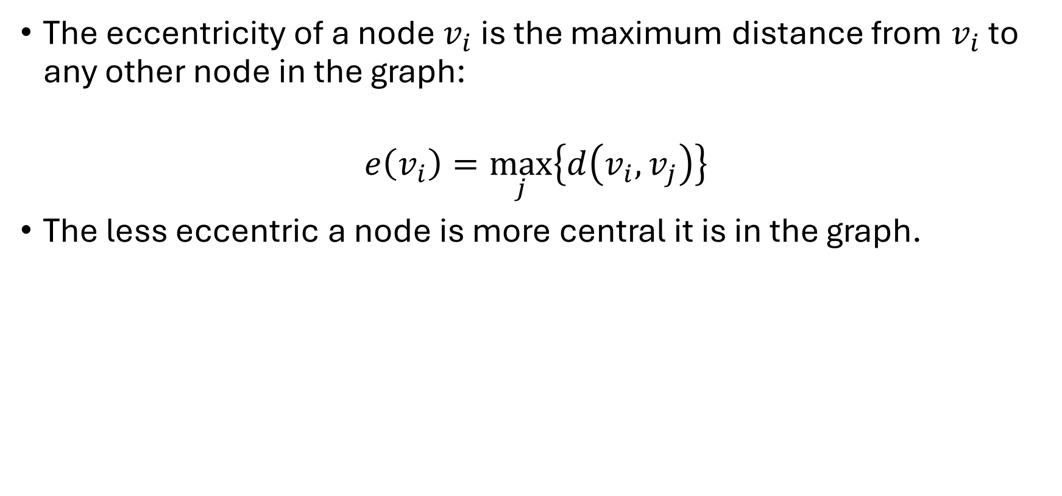
Eccentricity
The eccentricity of a node $v_{i}$ is the maximum distance from $v_{i}$ to any other node in the graph:
$$e\left(v_{i}\right)=\max_{j}\left\{d\left(v_{i}, v_{j}\right)\right\}$$
The less eccentric a node is more central it is in the graph.

Slide 41
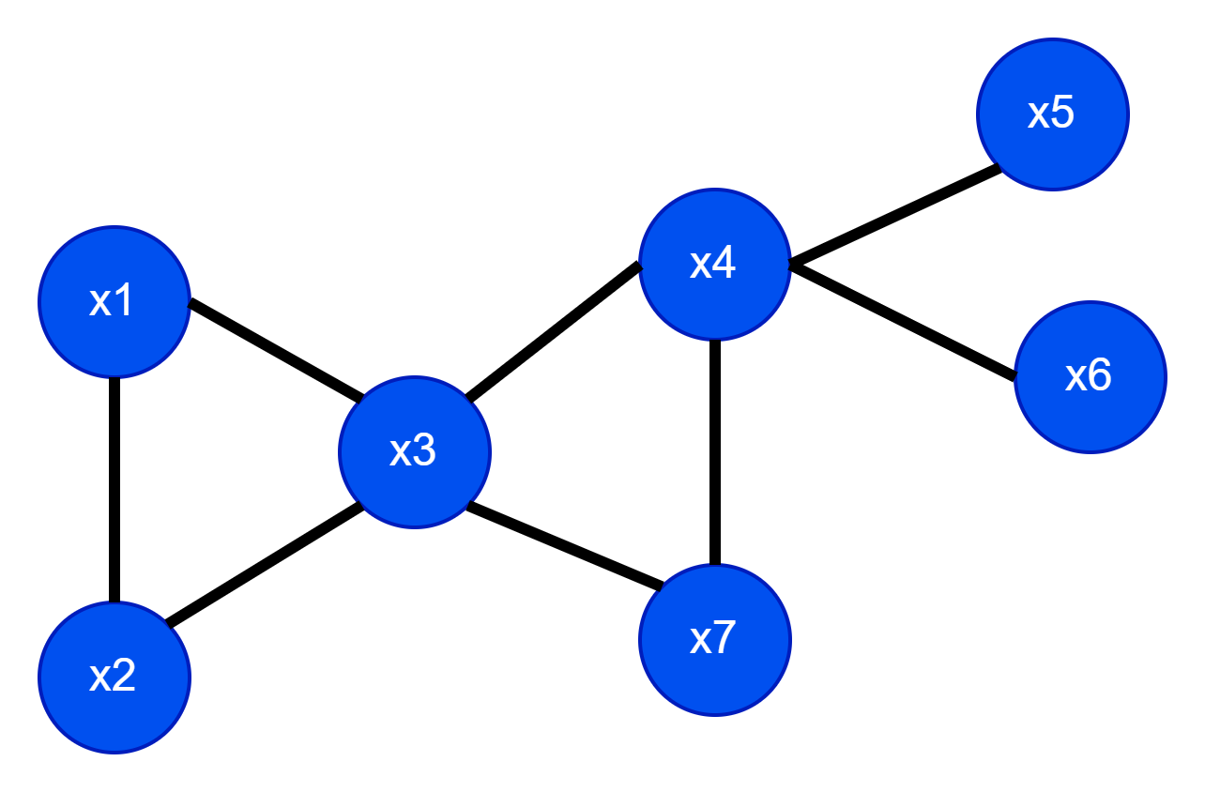
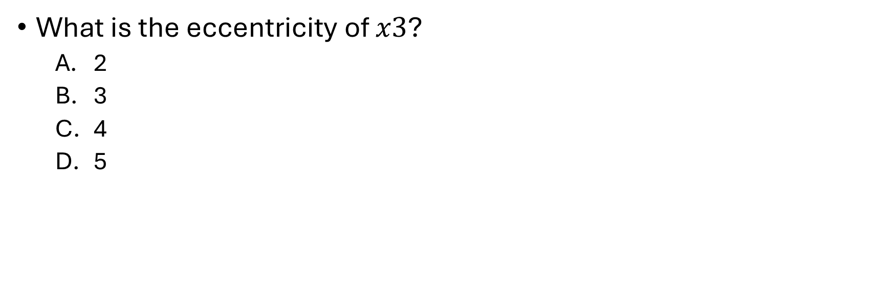
Example:
What is the eccentricity of $x3$?
2
3
4
5

Slide 42
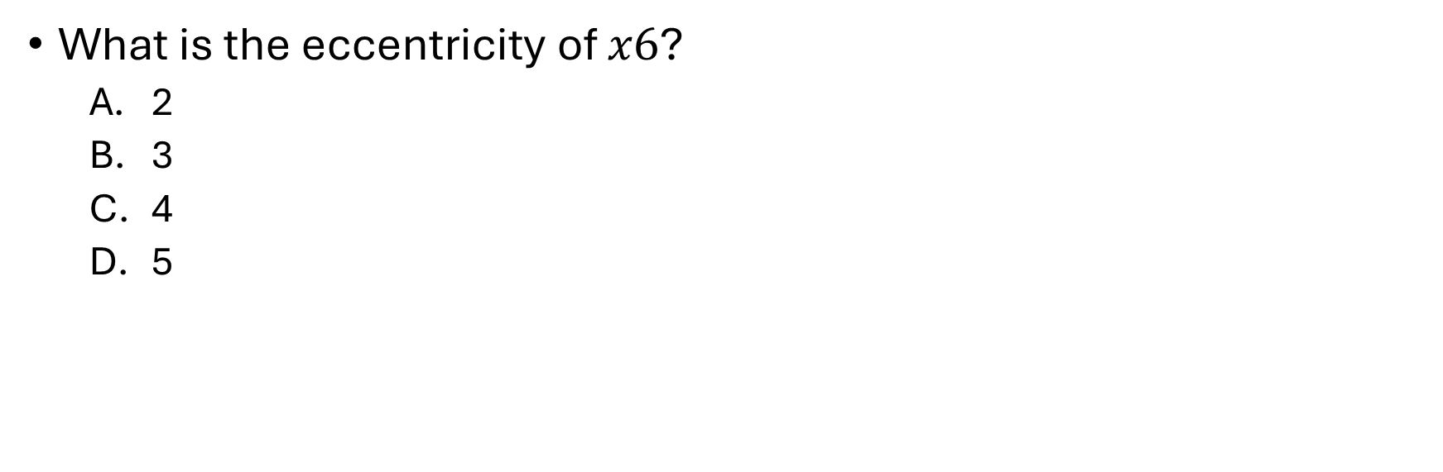
Example:
What is the eccentricity of $x6$?
2
3
4
5

Slide 43
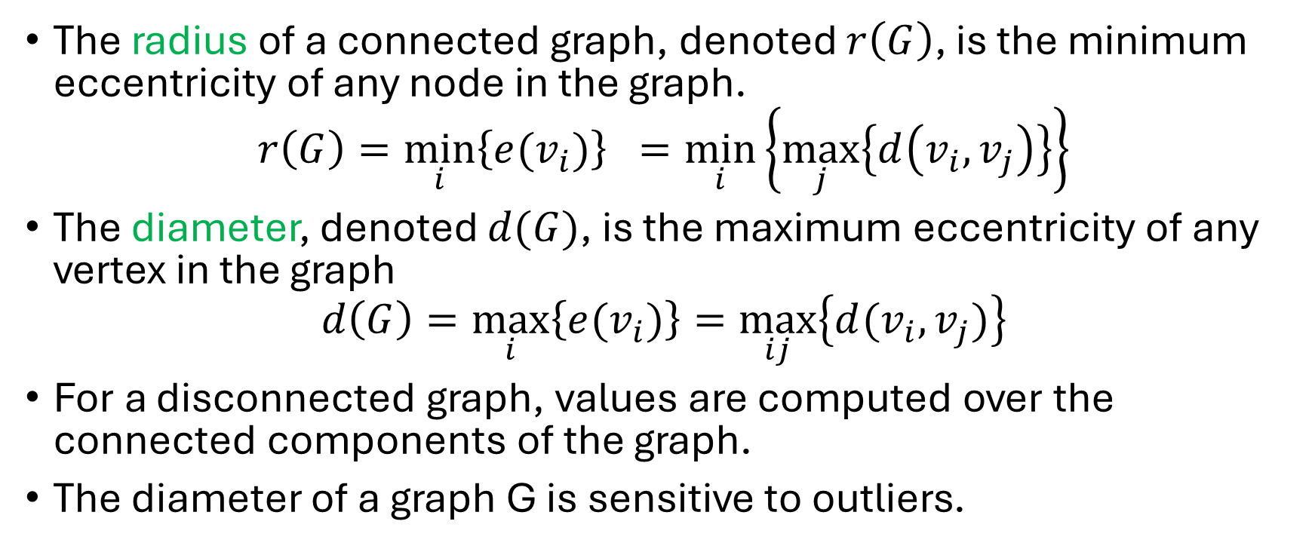
Radius and Diameter of a graph G
The radius of a connected graph, denoted $r\left(G\right)$, is the minimum eccentricity of any node in the graph.
$$r\left(G\right)=\min_{i}\left\{e(v_{i})\right\} =\min_{i}\left\{\max_{j}\left\{d\left(v_{i}, v_{j}\right)\right\}\right\}$$
The diameter, denoted $d(G)$, is the maximum eccentricity of any vertex in the graph
$$d\left(G\right)=\max_{i}\left\{e(v_{i})\right\}=\max_{ij}\left\{d(v_{i}, v_{j})\right\}$$
For a disconnected graph, values are computed over the connected components of the graph.
The diameter of a graph G is sensitive to outliers.

Slide 44
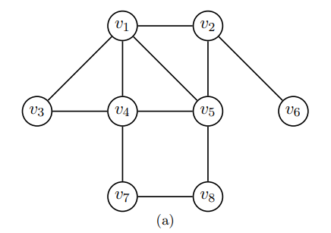
What is the radius and diameter of the following graph?
2
3
4
5

Slide 45
What is the radius and diameter of the following graph?
2
3
4
5

Slide 46
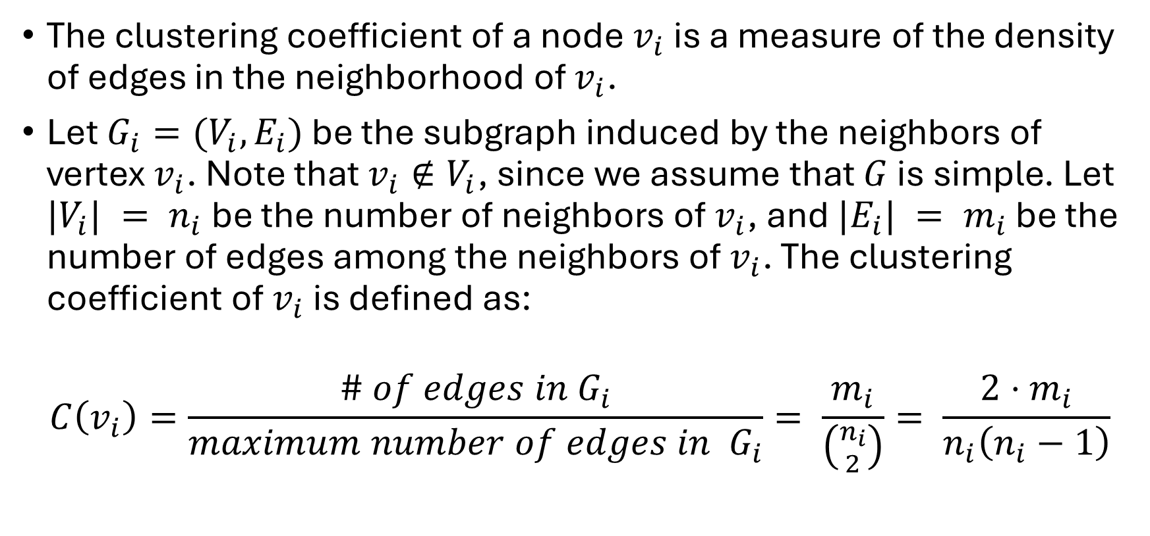
Clustering coefficient of a node
The clustering coefficient of a node $v_{i}$ is a measure of the density of edges in the neighborhood of $v_{i}$.
Let $G_{i}=(V_{i},E_{i})$ be the subgraph induced by the neighbors of vertex $v_{i}$. Note that $v_{i}∉V_{i}$, since we assume that $G$ is simple. Let $|V_{i}| = n_{i}$ be the number of neighbors of $v_{i}$, and $|E_{i}| = m_{i}$ be the number of edges among the neighbors of $v_{i}$. The clustering coefficient of $v_{i}$ is defined as:
$$C\left(v_{i}\right)=\frac{\# of edges in G_{i}}{maximum number of edges in G_{i}}= \frac{m_{i}}{\left({n_{i} \atop 2}\right)}= \frac{2⋅m_{i}}{n_{i}\left(n_{i}−1\right)}$$

Slide 47

What is the clustering coefficient of $v_{3}$?
1
1/3
1/2
1/6
6/10

Slide 48

What is the clustering coefficient of $v_{5}$?
1
1/3
1/2
1/6
6/10

Slide 49

What is the clustering coefficient of $v_{6}$?
1
1/3
1/2
1/6
6/10
Not defined

Slide 50
Clustering coefficient of a node
Note: Clustering coefficient of a node is not defined for nodes with degree less than 2.
Therefore, if we need, we can consider 0 for the clustering coefficient for nodes with degree less than 2.

Slide 51

Clustering coefficient of a node
How to interpret this value?
$C\left(v_{i}\right)=1→$ All neighbors are connected to each other.
$C\left(v_{i}\right)=0→$ None of the neighbors are connected to each other.
A higher clustering coefficient indicates a more tightly knit local community around the node.
Example:
Fraud Detection in Financial Networks
In a bank transaction network, accounts are nodes, and transactions form edges.
Fraud rings often have a high clustering coefficient since fraudulent accounts transfer money within a small, well-connected group.

Slide 52

Clustering coefficient of a graph
The clustering coefficient of a graph G is simply the average clustering coefficient over all the nodes, given as:
$$C\left(G\right)= \frac{1}{n}⋅\sum_{i}{C(v_{i})}$$

Slide 53

Clustering coefficient of a graph
The clustering coefficient of a graph G is simply the average clustering coefficient over all the nodes, given as:
$$C\left(G\right)= \frac{1}{n}⋅\sum_{i}{C(v_{i})}$$
What is the clustering coefficient of this graph?
3/8
3/16
5/16
1/2

Slide 54

$$C\left(G\right)=\frac{1}{8}⋅\left(\frac{3}{\left({4 \atop 2}\right)}+\frac{1}{\left({3 \atop 2}\right)}+1+\frac{2}{\left({4 \atop 2}\right)}+\frac{2}{\left({4 \atop 2}\right)}+0+0+0\right)=\frac{2.5}{8}=\frac{5}{16}$$

Slide 55
Clustering coefficient of a graph
The clustering coefficient of a graph G is simply the average clustering coefficient over all the nodes, given as:
$$C\left(G\right)= \frac{1}{n}⋅\sum_{i}{C(v_{i})}$$
What is the clustering coefficient of this graph?
3/8
3/16
5/16
1/2

Slide 56

Efficiency
The efficiency for a pair of nodes $v_{i}$ and $v_{j}$ is defined as $\frac{1}{d\left(v_{i}, v_{j}\right)}$
If $v_{i}$ and $v_{j}$ are not connected, then efficiency between these two vertices is $\frac{1}{∞} ≈0$.
Smaller the distance between two nodes, these nodes are efficient in communicating between them.
The efficiency of a graph is defined as $G$ is defined as the average efficiency of over all pairs of nodes.
$$\frac{2}{n⋅\left(n−1\right)}⋅\sum_{i}{\sum_{j>i}{\frac{1}{d\left(v_{i}, v_{j}\right)}}}$$

Slide 57

Measure of centrality
The notion of centrality is used to rank the vertices of a graph in terms of how “central” or important they are.
A centrality can be formally defined as a function:
$$c:V→ ℝ$$
$$that induces a total order on V$$
We say that $v_{i}$ is at least as central as $v_{j}$ if $c\left(v_{i}\right)≥c(v_{j}).$
A set has a total order if it has a partial order and every pair of elements in the set are comparable.

Slide 58

Degree centrality
The simplest notion of centrality is the degree $d_{i}$ of a vertex $v_{i}$.
the higher the degree the more important or central the vertex.
For directed graphs, one may further consider the indegree centrality and outdegree centrality of a vertex.

Slide 59



Degree centrality
$$d\left(v_{i}\right)= \sum_{j}^{n}{A(i, j)}$$
$$d\left(x_{3}\right)=\sum_{1}^{n}{A(3, j)}=4$$

Slide 60


Degree centrality
$$d\left(v_{i}\right)= \sum_{j}^{n}{A(i, j)}$$
$$d\left(x_{5}\right)=\sum_{1}^{n}{A\left(5,j\right)=1}$$

Slide 61




Degree centrality
$$d\left(x_{3}\right)=\sum_{1}^{n}{A(3, j)}=4$$
$$d\left(x_{5}\right)=\sum_{1}^{n}{A\left(5,j\right)=1}$$
$x3$ has higher importance than $x5$ according to degree centrality.

Slide 62

Eccentricity Centrality
Eccentricity centrality is thus defined as follows
$$c\left(v_{i}\right)=\frac{1}{e\left(v_{i}\right)}=\frac{1}{\max_{j}\left\{d(v_{i}, v_{j})\right\} }$$
The less eccentric a node is the more central it is.

Slide 63


What is the eccentric centrality of $x3$?
½
1/3
4
2
3

Slide 64

Closedness centrality
The closeness centrality uses the sum of all the distances to rank how central a node is.
$$c\left(v_{i}\right)=\frac{1}{\sum_{j}{d\left(v_{i}, v_{j}\right)}}$$
A node $v_{i}$ with the smallest total distance, $\sum_{j}{d\left(v_{i}, v_{j}\right)}$is called the median node.
Why is this important?

Slide 65
Closedness centrality
Closedness centrality tries to minimize the total distance over all the other nodes, and thus, a median node, which has the highest closedness centrality, is the optimal one to, say, locate a facility that minimizes the distance to all other points.

Slide 66

Closedness centrality
What is the closedness centrality of $x3$?
1/8
1/3
3
4
8

Slide 67

Closedness centrality
What is the eccentricity centrality of $x3$?
½
1/3
4
2
3

Slide 68

Betweenness centrality
For a given vertex $v_{i}$ the betweenness centrality measures how many shortest paths between all pairs of vertices include $v_{i}$.
This gives an indication as to the central “monitoring” role played by $v_{i}$ for various pairs of nodes.

Slide 69


Betweenness centrality
Let $η_{jk}$ denote the number of shortest paths between vertices $v_{j}$ and $v_{k}$, and let
$η_{jk}(v_{i})$ denote the number of such paths that include or contain $v_{i}$, then the fraction of paths through $v_{i}$ is denoted as
$$γ_{jk}\left(v_{i}\right)=\frac{η_{jk}\left(v_{i}\right)}{η_{jk}}.$$
If the two vertices $v_{j}$ and $v_{k}$ are not connected, we assume $γ_{jk} = 0$.
$$c\left(v_{i}\right)= \sum_{j≠i}{\sum_{\begin{aligned}k≠i \\ k>j\end{aligned}}{γ_{jk}}}$$

Slide 70

What is the betweenness centrality centrality of $v_{5}$?

Slide 71

 | Shortest paths | Shortest paths through $v_{5}$ $η_{jk}(v_{5})$
$$η_{12}$$ | 1 | 0
$$η_{13}$$ | 1 | 0
$$η_{14}$$ | 1 | 0
$$η_{16}$$ | 1 | 0
$$η_{17}$$ | 1 | 0
$$η_{18}$$ | 1 | 1
$$η_{23}$$ | 1 | 0
$$η_{24}$$ | 2 | 1
$$η_{26}$$ | 1 | 0
$$η_{27}$$ | 3 | 2
$$η_{28}$$ | 1 | 1
$$η_{34}$$ | 1 | 0
…

Slide 72
What is the betweenness centrality centrality of $v_{5}$?
$$c\left(v_{5}\right)=γ_{18}\text{+ }γ_{24}\text{+ }γ_{27}\text{+ }γ_{28}\text{ + }γ_{38}\text{+ }γ_{46}\text{ + }γ_{48}\text{ +} γ_{67} \text{+ }γ_{68}$$
$$c\left(v_{5}\right)=1+\frac{1}{2}+\frac{2}{3}+1+\frac{2}{3}+\frac{1}{2}+\frac{1}{2}+\frac{2}{3}=6.5$$

Slide 73


